Slide 1
Y11 Information Evening 25th March 2026

Slide 2
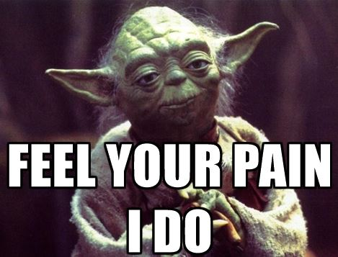

Slide 3


Slide 4


Slide 5


Slide 6

Attitude
Well being
Revision
Exam resilience
Memories
Notes:
Attitude in lessons has been spot on. Increase in number of ATL positives. Attidue towards all aspects of school life including punctuailty, uniform, diversity.
Well-being always at the forefront of the pastoral currciulm.
Revision sessions been going on, revise til 5, canteen open every night after school, indepdnent study on a wednesday durign form
Studnets have been looking back at their time at Fulford.
Eam resileince skills to thrive and not panic in exams.

Slide 7

Year 11 Leavers' Assembly and Prom
Tuesday 30th June
Link for hoodies will be live soon

Slide 8
Looking ahead to September

Slide 9

Fulford Sixth Form
Provisional offer letters to the Fulford Sixth Form applicants have been issued last week.
If there are any issues, please get the students to see Mrs Davies or to email the address on the letter: sixthform@fulford.york.sch.uk.
| 9

Slide 10
Other options
York College/Other Sixth Form Colleges
Applications should now have been made to York College or any other Sixth Form providers.
Mrs Birkby is available to support students with their applications, and to advise on results day.

Slide 11
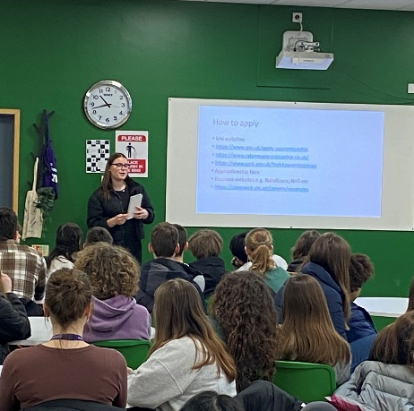
Apprenticeships
Apply directly to employer
Different levels
Competition is fierce
You can apply for as many as you like
https://amazingapprenticeships.com/
https://www.apprenticeships.gov.uk/

Slide 12
If you have any questions relating to pastoral care, please feel free to stay behind and we can have a chat.

Slide 13
Outline of the talk:
The final weeks of Year 11
How to support your child during exams
KS4 Exams and NEA (coursework)
Results Day
Securing post-16 places for September

Slide 14
The final push!
Students have responded positively to the support teachers are giving them:
Revision resources shared via Teams and Class Charts
Personal feedback about their mock exam results
Exam scripts are a fantastic revision resource
Interventions classes: Maths, English, Science
Lessons focused on exam approaches and past papers
Attendance at Revise Until Five and 'Power Hour' on Tuesdays and Thursdays

Slide 15
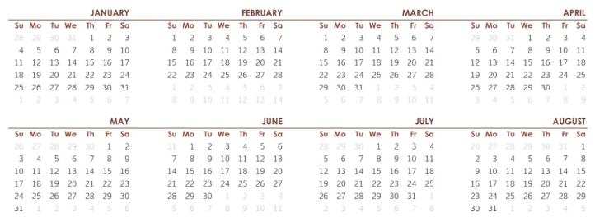
The final push!
25
7 weeks of school left
Final day: Friday 5th June
Contingency day: 24th June
5
24

Slide 16
The final push!
25
24
30
MFL Orals from Fri 24th April
Art exams 30th April/1st May
5
24

Slide 17
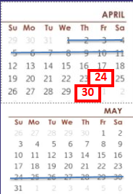
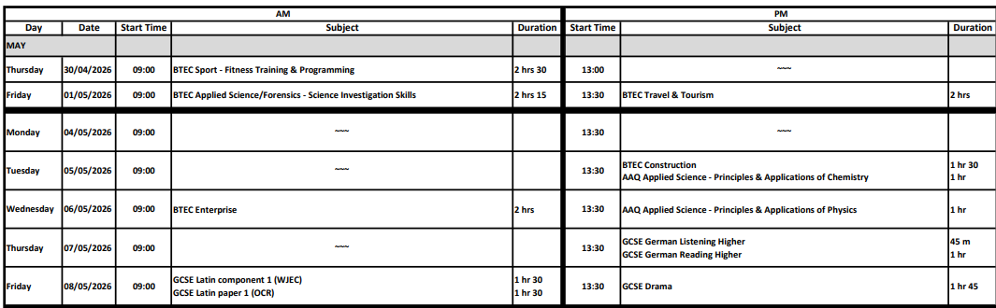
The final push!
ART

Slide 18
The final push!
25
Year 11 Adapted Timetable
3 weeks: scheduled exams supported by revision sessions
5
24

Slide 19
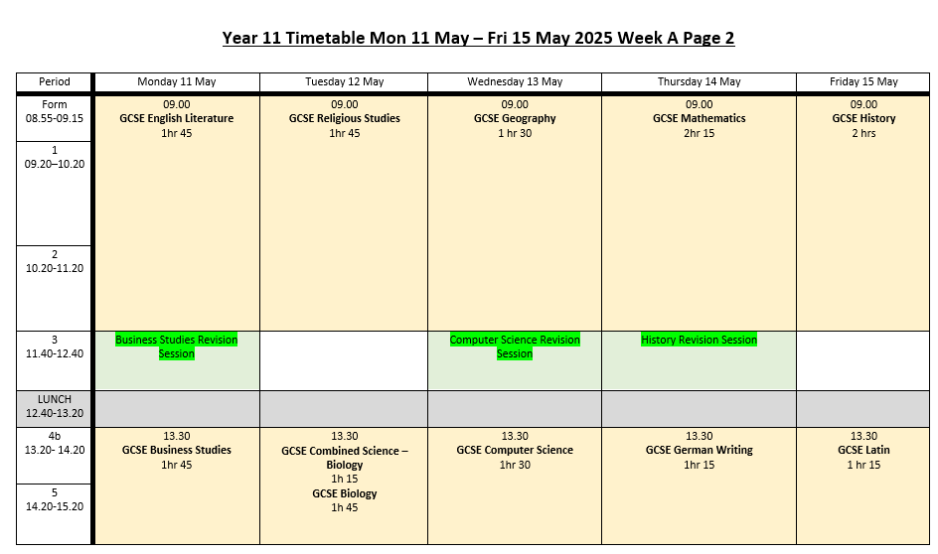
Year 11 Adapted Timetable

Slide 20
Support at home

Slide 21
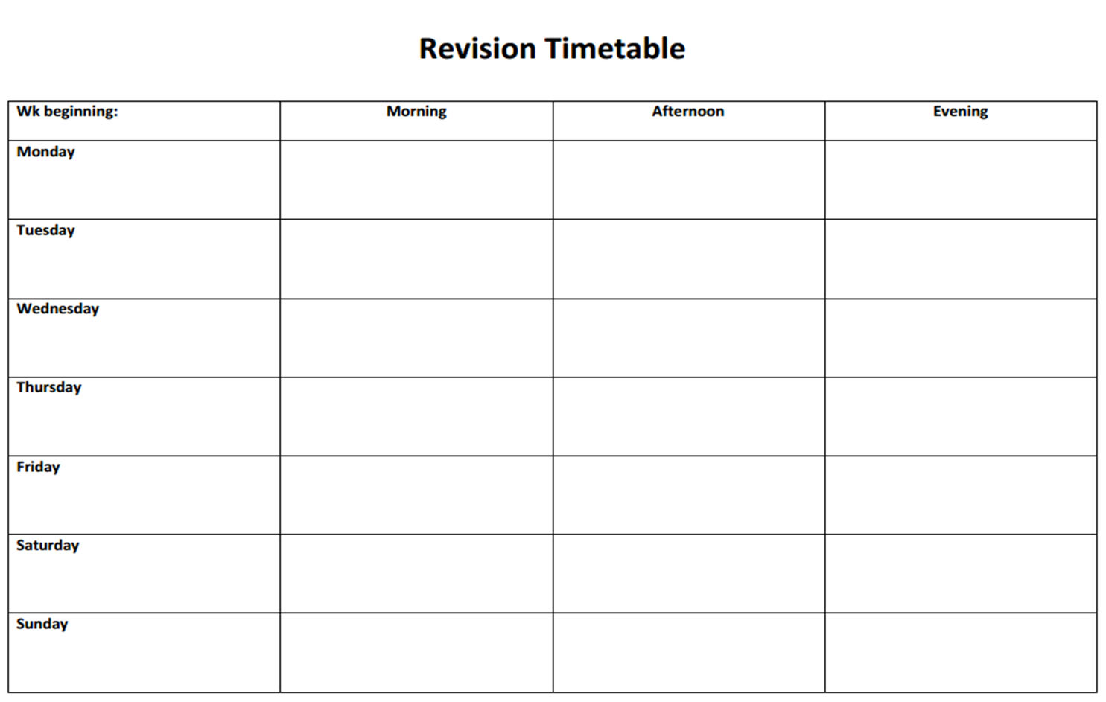
How to support

Slide 22
How to support
Study effectively
Practice!
Short bursts – take breaks
Recall e.g. using flash cards/cover and write
Spaced practice, interleaving
Not last minute: be organised

Slide 23
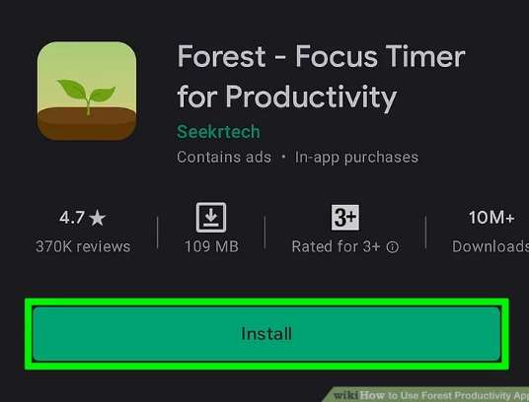
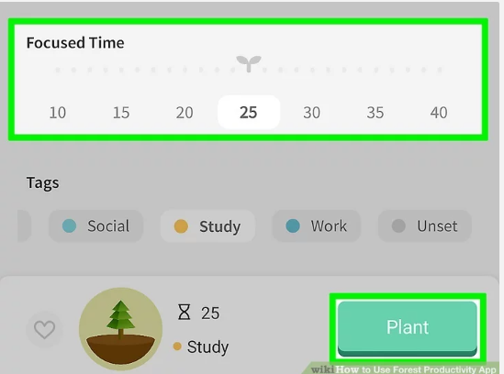
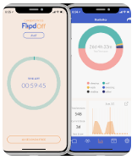
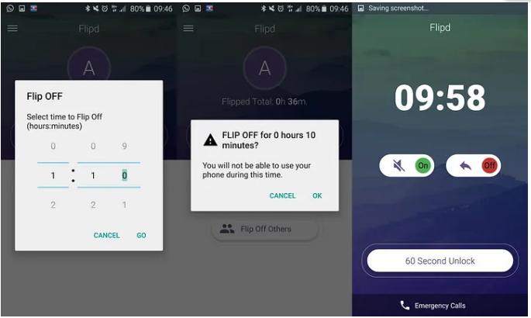

Slide 24
When will the students find out their NEA marks?
Class teachers will tell students the mark they have been given for their NEA.
This is timed so that students will have an opportunity to appeal before the marks are submitted to the exam board.
e.g. submission deadline 8th May = results 24th April

Slide 25
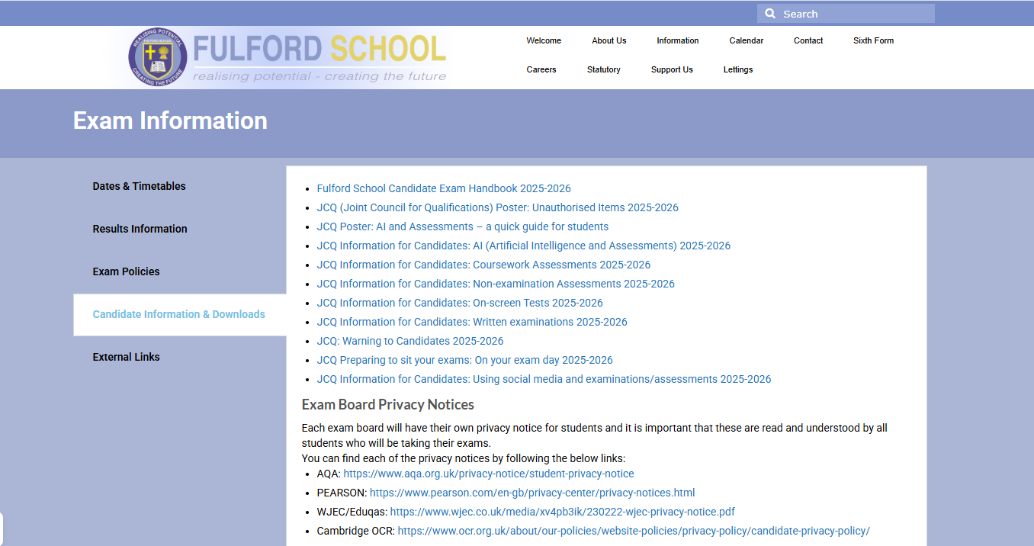
How can I access information and guidance about exams?

Slide 26
BTEC and GCSE Exams
Frequently Asked Questions

Slide 27

.
What are the times of the exams?
Morning exams: 9am
Afternoon exams:1.30pm
Notes:
Stress that students shouldn’t be late in. If they are (for example traffic delays buses) then they need to let us know that they are running late. There is limited flexibility in how long we can delay the start of an exam for.

Slide 28
How will the students know where to go and when for their exams?
A personal exam timetable will be issued via their form tutors. This will tell them which room and seat number they are sitting in.
Clashes will be displayed on the personalised timetable. Students will get a letter explaining the arrangements in the event of a clash.
The full exam timetable is available on the school website.
https://fulford.york.sch.uk/wp-content/uploads/2026/02/Summer-2026-Examination-Timetable-1.pdf

Slide 29
Do students need to come into school every day?
Up to Friday 5th June students are expected to be in school all day every day, either in an exam, a revision session or in their usual lesson.
From Monday 8th June, students will be able to study at home and only need to be in school for exams. There will be revision sessions available for students to attend and there will be space in school where students are able to work independently.

Slide 30
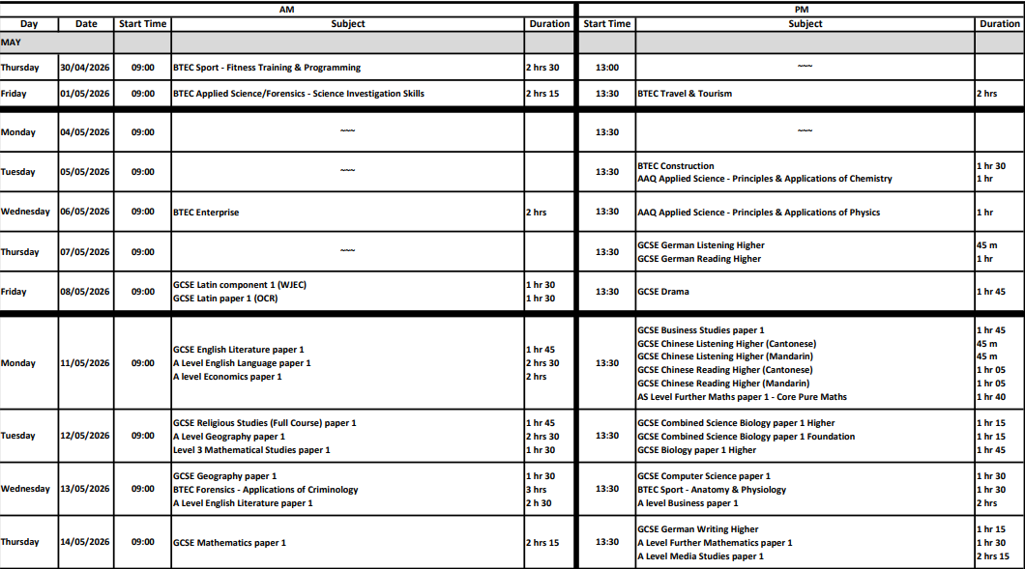
Make sure they know their timetable. Individual timetables will show rooms.

Slide 31
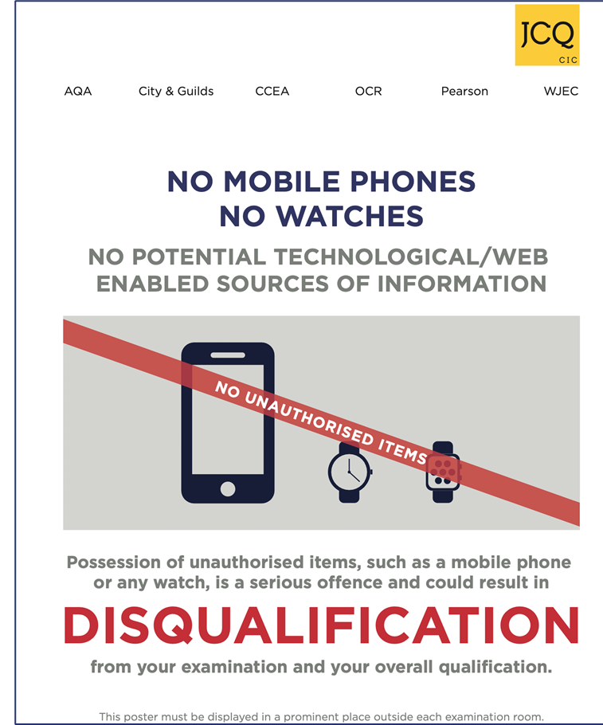
In the exam room
Students need to be in full uniform for every exam.
Students should bring all the equipment they need into each exam.
Students must not bring anything else into the exam venue.

Slide 32
What happens if the student is ill on the day of the exam?
Parents/carers must call the school office on the day by 8.30am.
Special consideration may be applied if the student sits the exam.
Parents/carers may be required to complete a form for the absence that will be logged with the exam board.
Students will not get a chance to re-sit the paper.
Notes:
Big question is whether they are well enough to sit the exam.

Slide 33
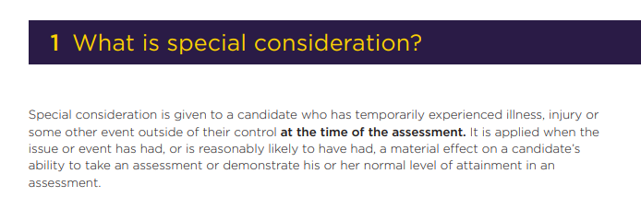
What should I do if my child needs special consideration?

Slide 34
What happens if the student is late to an exam?
Students – or parents/carers - must contact the school if they think they will be late.
If they are late beyond a certain point, students cannot be admitted into the exam.
Lateness is disruptive to all students taking the exam.
Notes:
AR

Slide 35
When do the exams end?
The list of exams will be detailed on each personalised timetable. However all students must be available for all contingency days.
Contingency day 1 | Wednesday 10 June PM only
Contingency day 2 | Wednesday 24 June All day
Notes:
AR

Slide 36
What happens if exams are cancelled?
Very unlikely! We will use a Teacher Assessed Grading system. We have retained their mock papers to inform this process, if necessary.
Notes:
AR

Slide 37
Results Day
Thursday 20 August

Slide 38
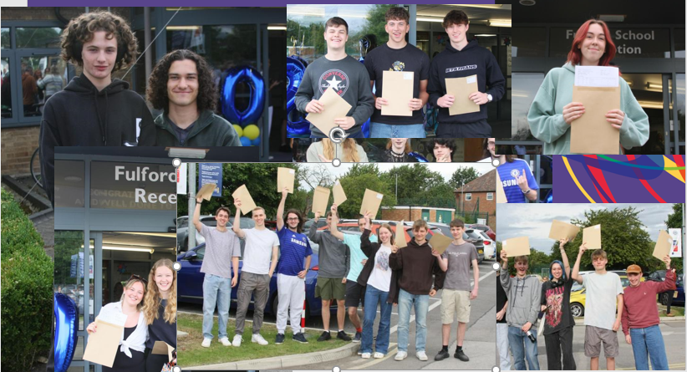
Results Day
Collection from 8AM
Teacher advise/support available Thursday and Friday
Students are expected to collect results in person.
If students are unable to be in school in person they can arrange for someone else to collect them on their behalf. We need to know this in advance.
We are not able to email results out this year.
The DFE are rolling out an app that will allow students to download their results at 11am on results day.
https://fulford.york.sch.uk/exams/

Slide 39
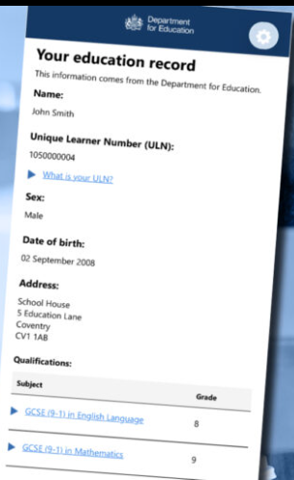
The app aims to provide a modern, digital alternative to paper certificates and reduce administrative burdens by providing instant, portable access to results.
Beyond receiving results, users can check their information for accuracy and securely share their educational achievements with future schools, colleges, or employers.
Download the app from the relevant app store.
Students need to be registered to the correct account on an individual basis.
We'll look to do this on Wednesday's as part of the Revise till 5 sessions.
Other slots will be available.

Slide 40
Can students have the exam marks reviewed?
There is an appeals process:
The process includes a review of the marked paper, not a re-mark. If the original mark is found to be reasonable, the mark will be upheld. Most appeals are unsuccessful.
The result of any appeal replaces the original mark. Do remember that marks can go down as well as up.
Students can request copies of their scripts to inform whether a review of marking would be an option.
All reviews must have a completed and signed form. Payments should be made by cash or cheque, and must received before the review is processed.
All deadlines and fees will be available on the school website on results day.

Slide 41
Key dates
Exams
BTECs start Friday 1 May
GCSEs start Thursday 7 May
Exam leave starts Mon 8 June
GCSE exams end Tuesday 16 June
Results Day Thursday 20 August

Slide 42
Any questions?

