Slide 1
Year 7 Information Evening

Slide 5
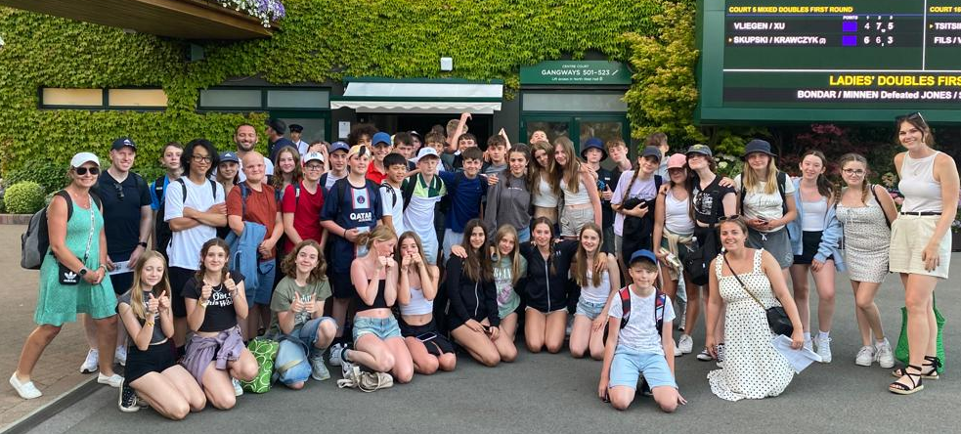
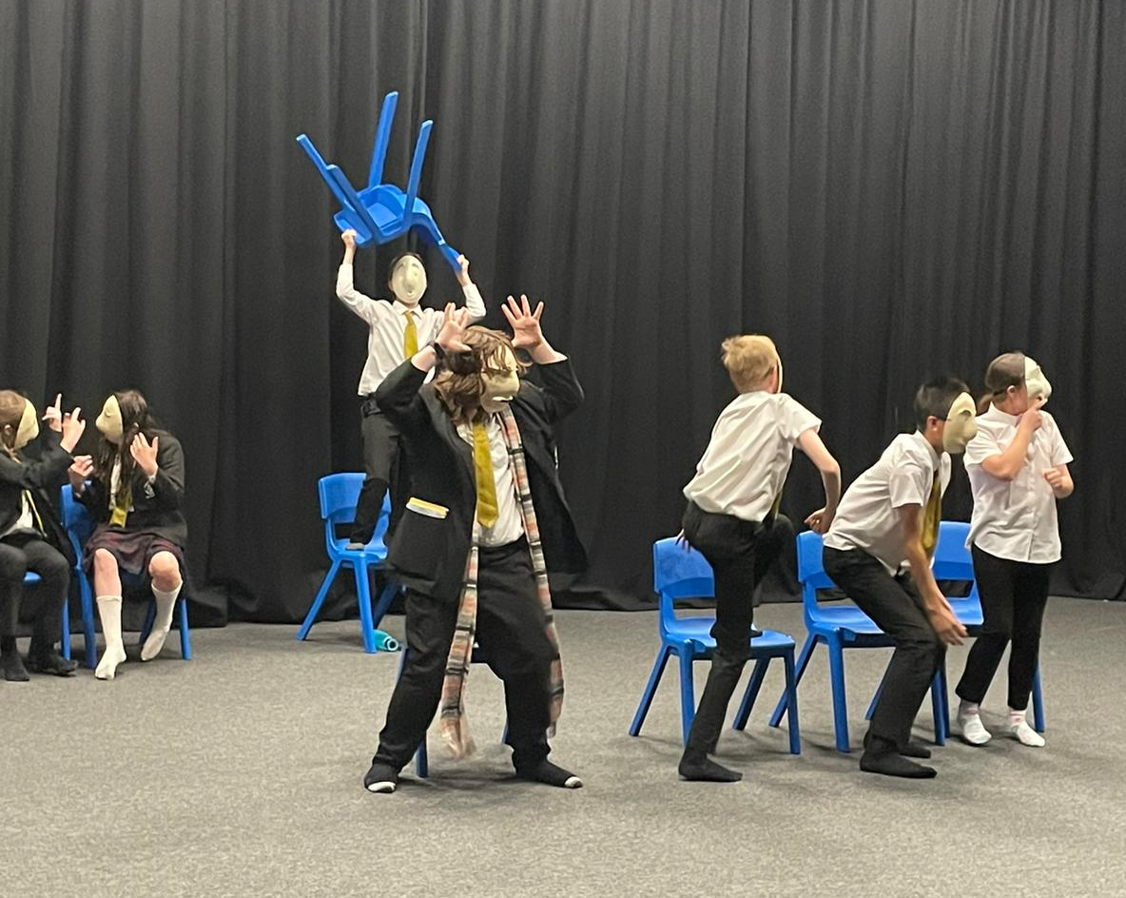
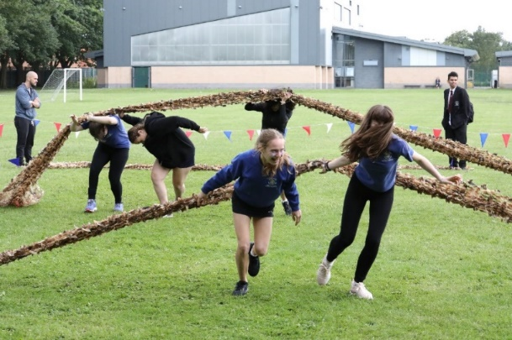
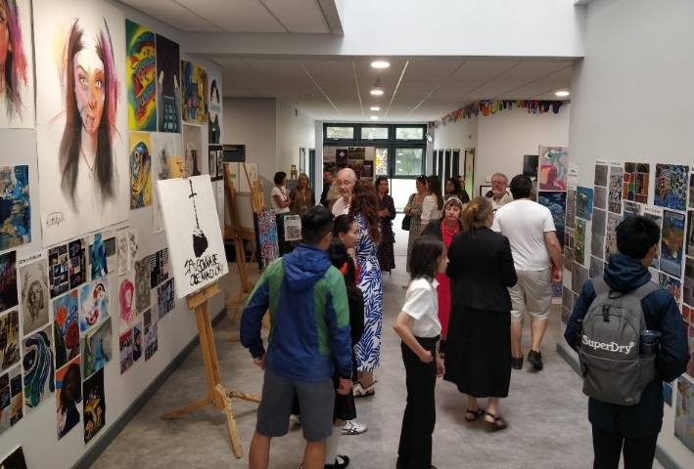
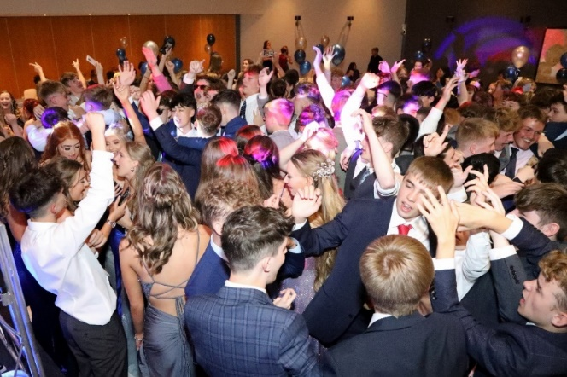

Slide 6
Notes:
I am a highly motivated individual who understands the transformative power of education and the significance of raising student aspiration and progress. Having faced difficulties in my own education being stood here today is a testament to the impact that a teacher who believed in me had on turning my life around and achieving personal success.

Slide 9
Ofsted says we are outstanding
Academic Excellence
Great behaviour and attitudes to learning
A fantastic sixth form
Pupils who challenge discrimination and prejudice
Very high expectations of all
Top quality teachers
A safe school, focussed on wellbeing

Slide 10
Fulford is amongst the very best schools in England
You make really good progress
You get fantastic exam results
You get lots of opportunities which are not available in other schools
You feel safe and secure

Slide 11
0.60

Slide 12
Average Grade B+

Slide 13
You have a great opportunity
What are you going to do with it?

Slide 19
FULFORD SCHOOL
Honesty
Empathy
Ambition
Respect
Tolerance

Slide 21
Great start

Slide 23
Pastoral
Support
(Year 7)

Slide 24
We are here to support you & your children

Slide 25
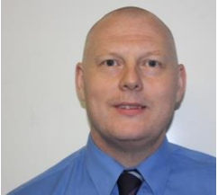
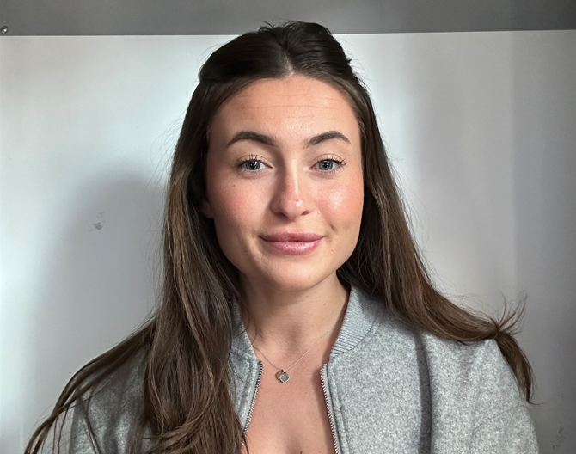
Parental first point of contact.
Mr Gatenby
Head of Year
Ms Haythorne
Assistant Head of Year

Slide 26
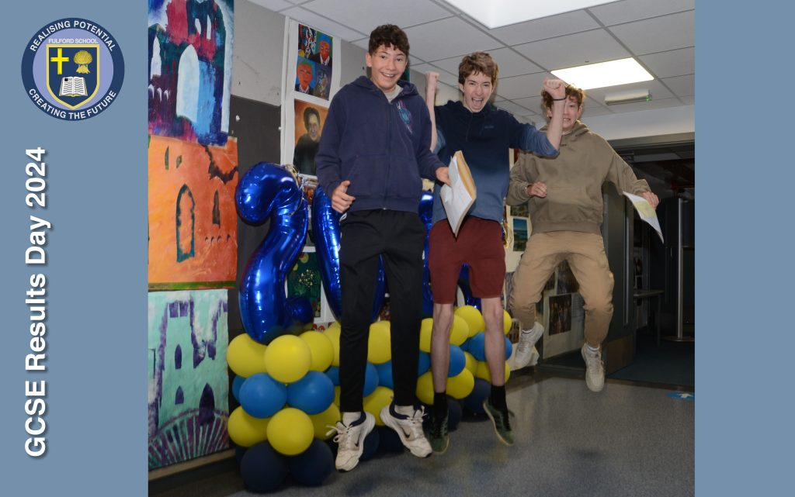
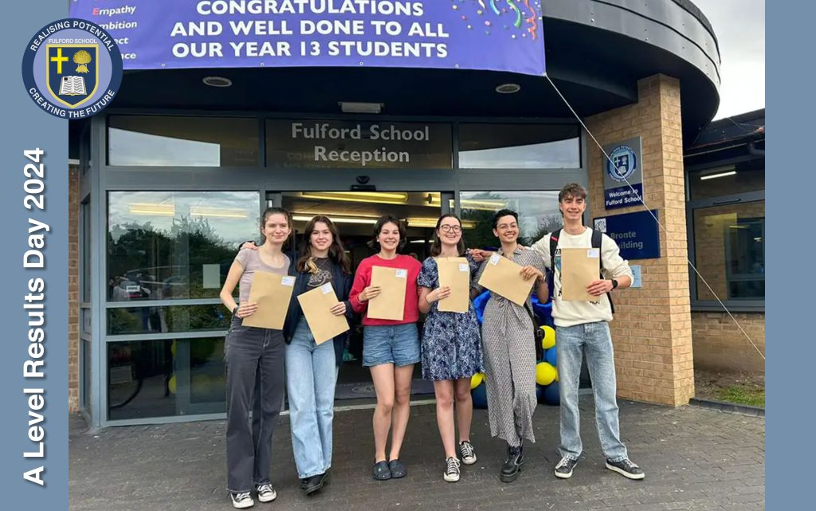

Slide 27
Pastoral Care
Learning Support
Safeguarding
Mental Health
Academic Support
Future pathways guidance

Slide 28
Who else supports?
Year Teams Leaders
Form Tutors
Attendance Team
School Nurse
Wider Pastoral Team
Mr Copeland and Mrs Elsworth
All staff are here to help children make progress
and flourish into confident young people ready
for life in Modern Britain.

Slide 29
What your children do to look after themselves?
Build relationships
Join in, get involved
Healthy Diet
Exercise
Sleep
Screen Time
Talk

Slide 33
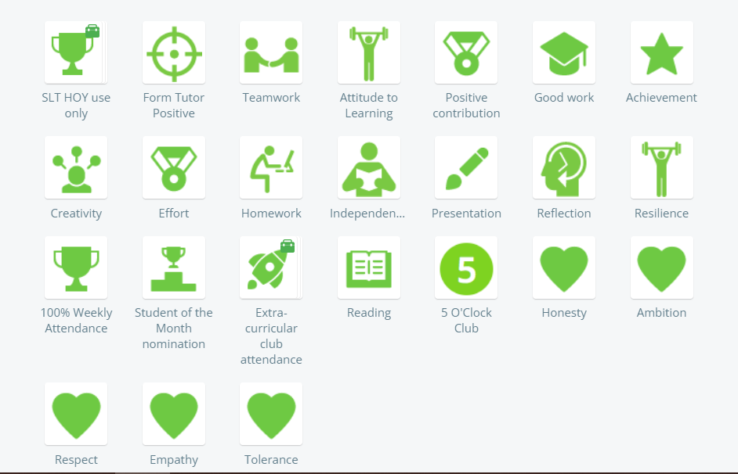

Slide 35
(Pupils) What if I can’t speak to anyone?
HONESTY, EMPATHY, AMBITION, RESPECT and TOLERANCE

Slide 37
FULFORD SCHOOL
Honesty
Empathy
Ambition
Respect
Tolerance

Slide 38
Year 7 Pledges
Pledge – a commitment or promise to something.
Can you think about a time you have done something relating to the HEART Values?
BEST – something you have done or seen somebody else do at Fulford School so far.

Slide 39
Our HEART values are really important to us at Fulford, we live them out every day to make our community strong and to be the best people we can.
Throughout the year you will complete a variety of pledges that correspond to our HEART values.
The pledges will include a range of activities that will be completed individually, as a form or in groups.
Each time you fulfil a pledge you’ll receive a HEART award positive.

Slide 40
Pledge 1: I will be part of the form family and help deliver the form breakfast.
This half term we will be having a Year 7 form breakfast. You will be in charge of your forms meal time!
You’ll be eating in your form groups, serving each other and your form tutor, as well as clearing up and making sure the canteen is left clean & tidy.

