Slide 1

Welcome to 7xx
Tutor name

Slide 2

The Purpose of Form Time
Their morning ‘base’ in school.
Consistency, familiarity & belonging – their little ‘school family’
Opportunity to get things right before heading to main lessons, e.g. uniform, equipment.
Create long-lasting relationships with students & form tutor (they’ll stay in this form for 5 years).
Participate in a varied form time programme that looks to improve their personal development.

Slide 3
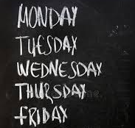
Y7 Weekly Form Time Plan
Monday –Reading + Notices + Newsround
Tuesday – Assembly (Video)
Wednesday – Pledge Tasks ( themed group activities )
Thursday –Reading & data (positives, negatives, attendance)
Friday – Live Assembly (Hall)

Slide 4
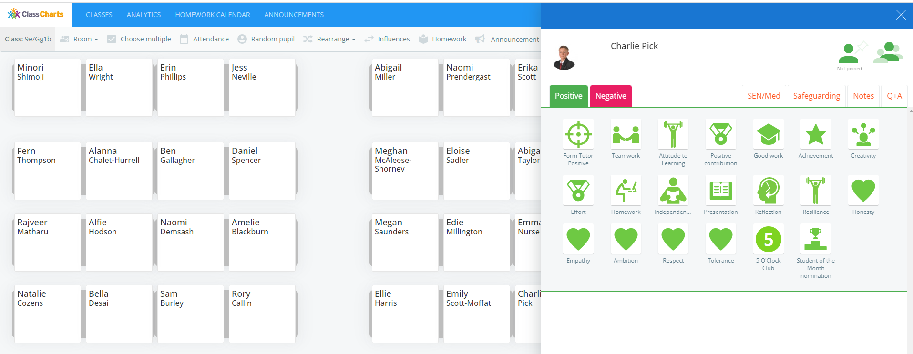
Classcharts ( More detail from Mr Bailey)
Classcharts is the main way school communicates with parents. You get updates on behaviour (positives & negatives) at the end of each day. Your child's homework will also be set via classcharts.
During form time students review classcharts and tutors monitor behaviour this way.

Slide 5

Positives .
Heart Awards.
Shout outs.
Subjects: ‘Student of the Month’
Rewards
Rewards Assemblies – with certificates, draws & prizes
End of year trip – criteria will be announced nearer the trip

Slide 6
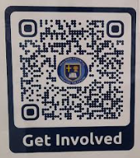
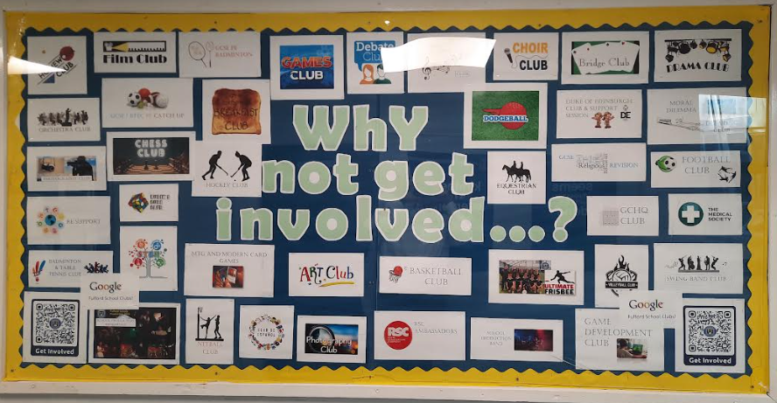
Clubs
Watchout for class charts announcements – one will be sent when the extra-curricular offer is finalised & launched
Google ‘Fulford School Clubs’ – top link!
https://fulford.york.sch.uk/y6-transition-2022/

Slide 7

6th Form Student leader
What makes for a successful journey through Fulford school?

Slide 8

Any questions?

