Slide 1


Mr Bailey
Assistant Headteacher
Supporting your child at Fulford
(Reading & Class Charts)
HONESTY, EMPATHY, AMBITION, RESPECT, TOLERANCE

Slide 2

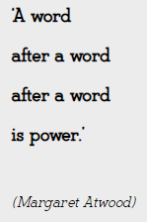

Slide 3




Slide 4




Year 7:

Slide 5
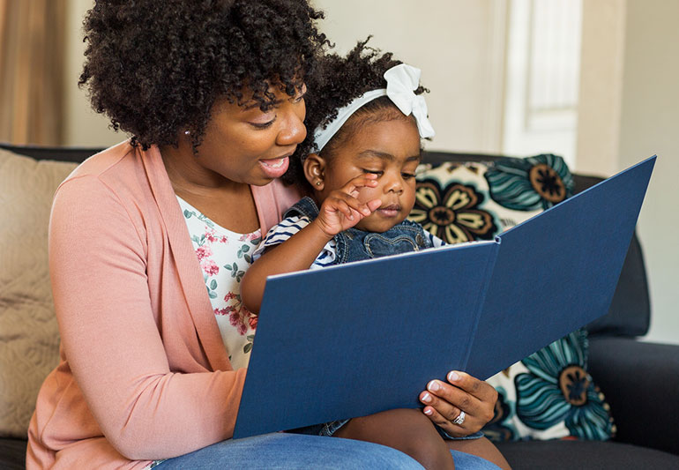
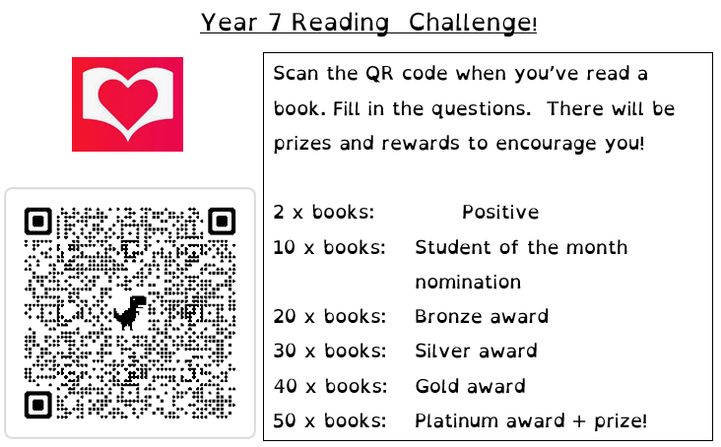
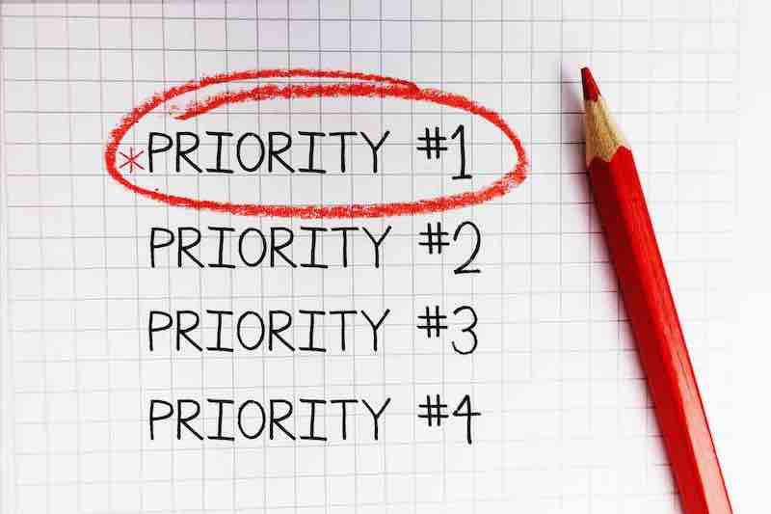

Slide 6
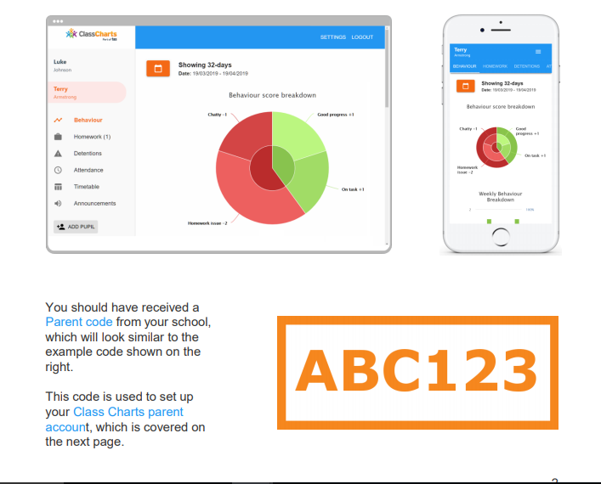
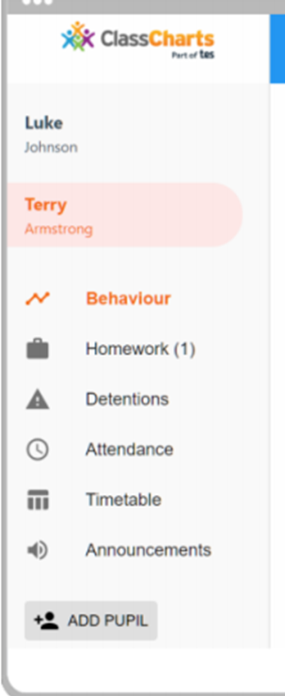
HONESTY, EMPATHY, AMBITION, RESPECT, TOLERANCE

Slide 7
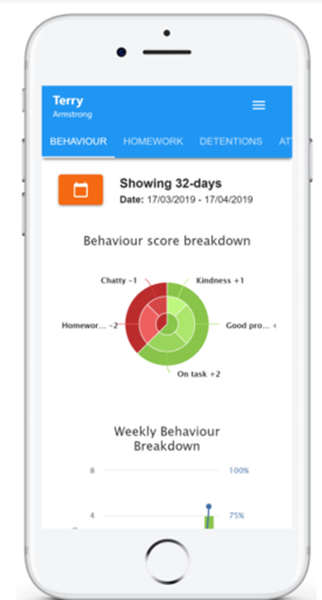
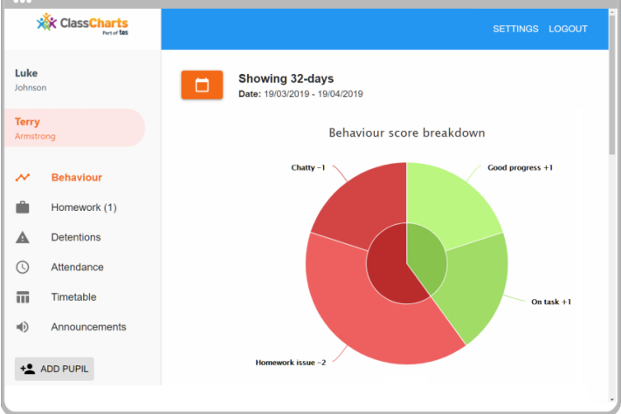
How is the day/ week/ month going?
HONESTY, EMPATHY, AMBITION, RESPECT, TOLERANCE

Slide 8
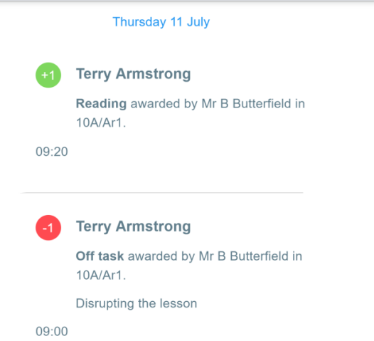
Regular Updates
HONESTY, EMPATHY, AMBITION, RESPECT, TOLERANCE

Slide 9

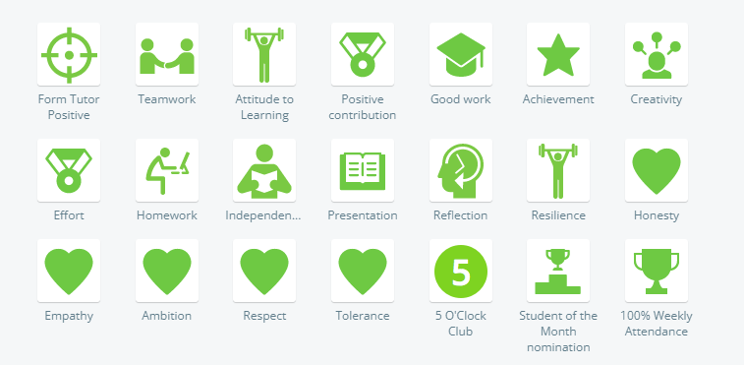
Positive Behaviour Recognition
HONESTY, EMPATHY, AMBITION, RESPECT, TOLERANCE

Slide 10
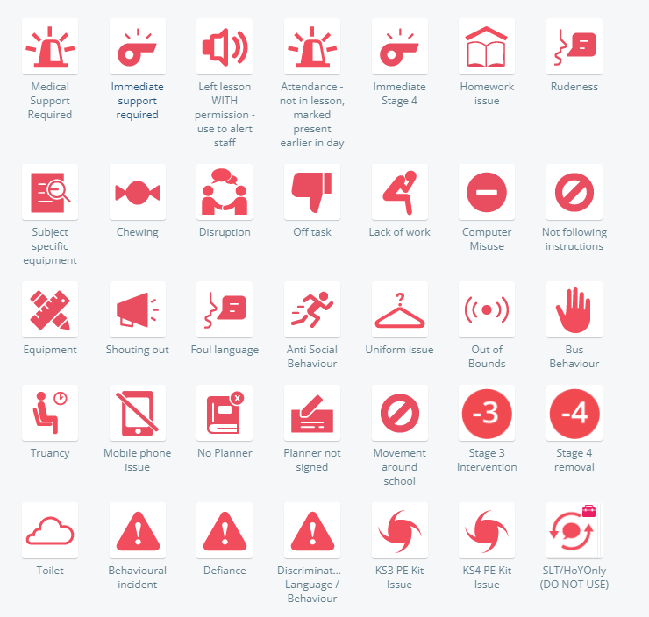
HONESTY, EMPATHY, AMBITION, RESPECT, TOLERANCE

Slide 11
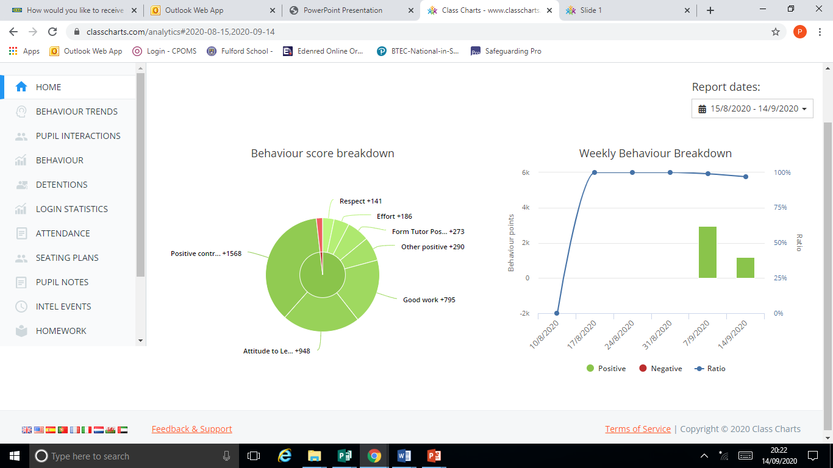
Patterns
Regular Updates
HONESTY, EMPATHY, AMBITION, RESPECT, TOLERANCE

Slide 12
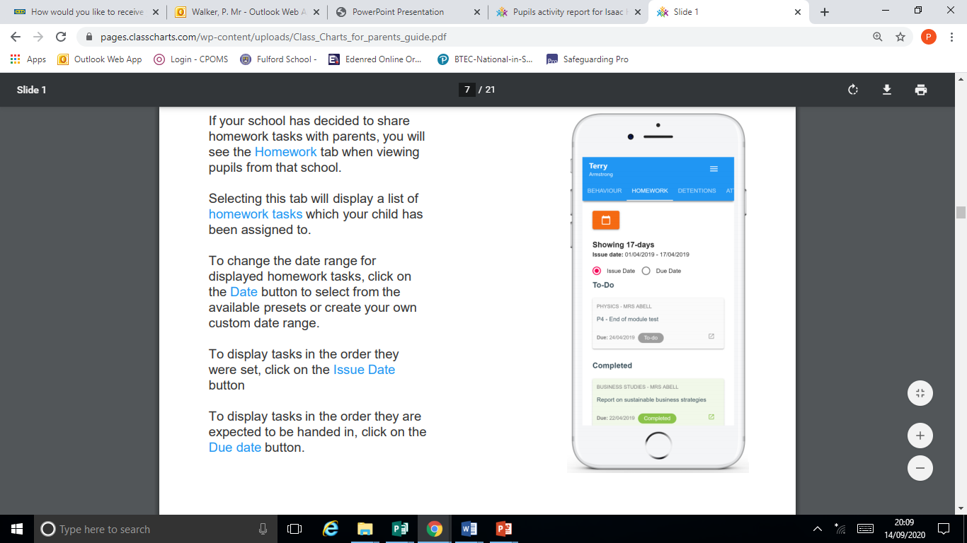
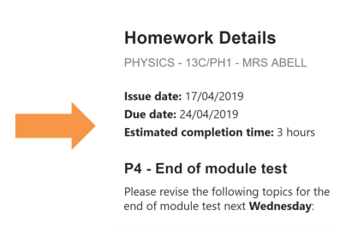
Homework
HONESTY, EMPATHY, AMBITION, RESPECT, TOLERANCE

Slide 13
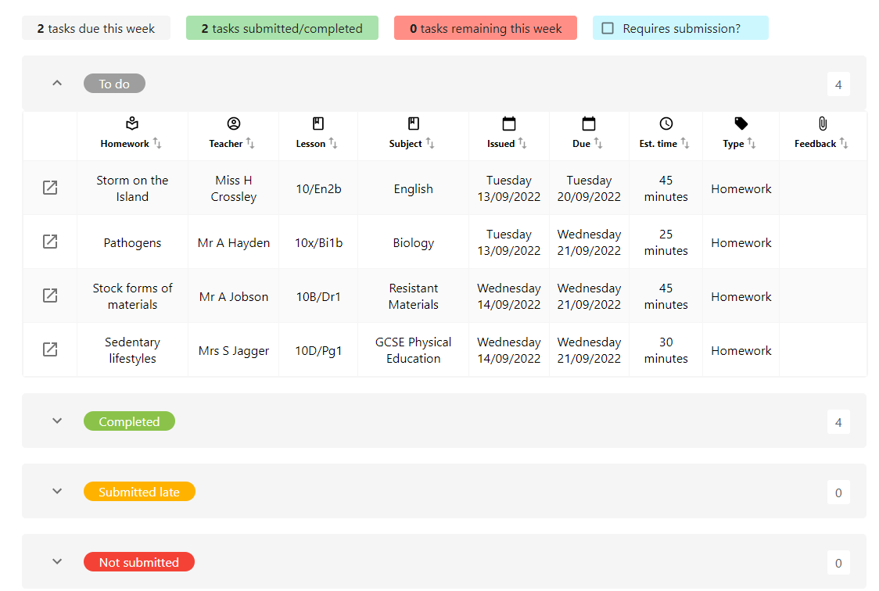
Homework
HONESTY, EMPATHY, AMBITION, RESPECT, TOLERANCE

Slide 14
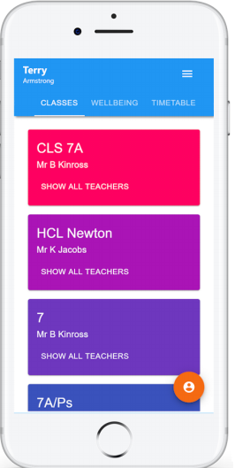
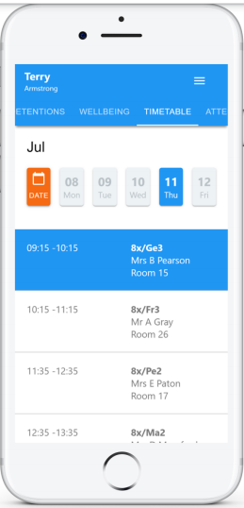
Timetable and Classes
HONESTY, EMPATHY, AMBITION, RESPECT, TOLERANCE

Slide 15
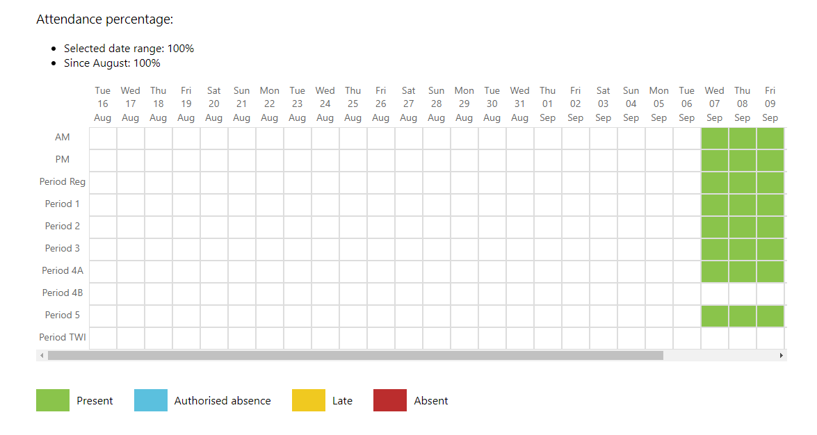
Attendance
HONESTY, EMPATHY, AMBITION, RESPECT, TOLERANCE

Slide 16
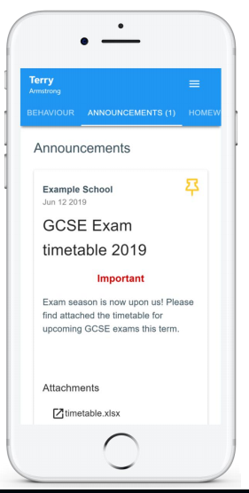
Announcements:
Students
Parents
Both
HONESTY, EMPATHY, AMBITION, RESPECT, TOLERANCE

Slide 17


