Slide 1
Pastoral Information & Support
HONESTY, EMPATHY, AMBITION, RESPECT, TOLERANCE

Slide 2
Honesty
Empathy
Ambition
Respect
Tolerance
HONESTY, EMPATHY, AMBITION, RESPECT, TOLERANCE

Slide 3
FULFORD WAY
Be Polite
Present yourself and your work neatly
Respect other people’s points of view
Cooperate with all staff
Hold doors open for others
Put litter in bins
Move calmly around the school
HONESTY, EMPATHY, AMBITION, RESPECT, TOLERANCE

Slide 4
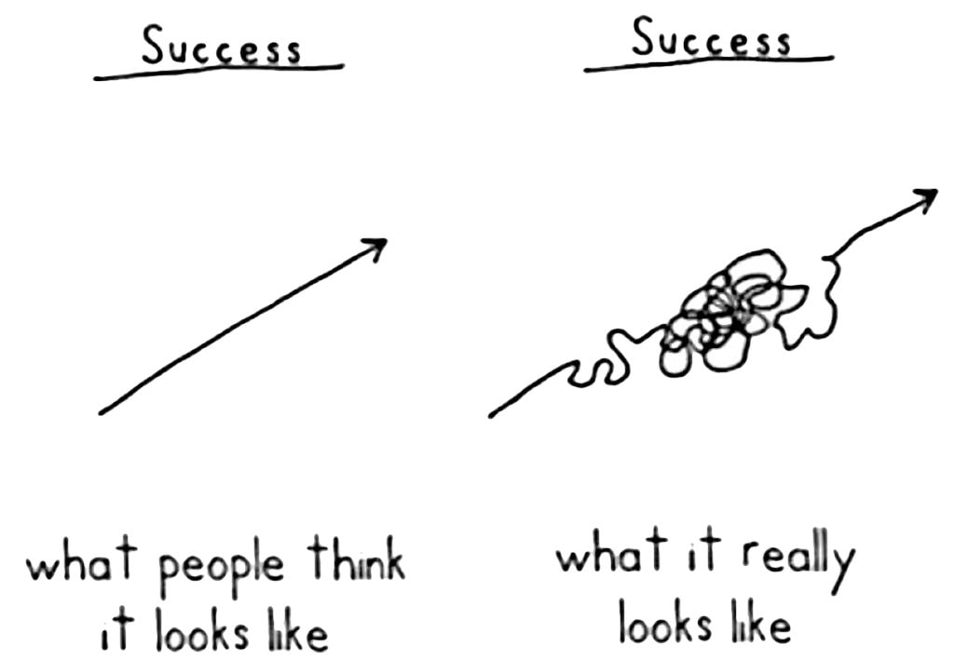

Slide 5
Pastoral Support
Head of Year
Assistant Head of Year
Form Tutor
Progress Leader
Specialist Wellbeing Staff
Curriculum Leaders
Subject Staff
Other students - wide range of student leadership roles.
HONESTY, EMPATHY, AMBITION, RESPECT, TOLERANCE

Slide 6
Head Of Year, Assistant Head of Year & Progress Leader
Initial port of call for all enquiries.
Oversee welfare & progress of all Year 7 students.
Overall Lead: Russell Harris – Deputy Headteacher
Progress Leader
Monitor and tracks the academic progress of the Year 7 cohort.
Link with staff, students and parents to put in place interventions when there are concerns.
Key Contact: Sam Lynn, Progress Leader
AHOY Dean Wharton
Practical support
Day-to-day arising issues
Parent contact
Dealing with student worries
Resolving any issues, i.e. friendships, misplaced items
Uniform
HOY Fay Chapman
Attendance & behaviour (rewards, interventions, Class Charts, report data)
Academic progress (alongside Progress Leader)
Implement form time programme & assemblies
General organiser!

Slide 7
Wellbeing, Safeguarding and Learning Support
Wellbeing and Safeguarding –
Key Contact - Paul Walker (Assistant Headteacher Safeguarding, Inclusion and Equality)
Learning Support -
Key contact: Anna Mehta (SENCO)
Student Wellbeing - Social, Emotional and Mental Health needs
Key Contact: Ashleigh Stewart (School Social Worker and Wellbeing Leader)
HONESTY, EMPATHY, AMBITION, RESPECT, TOLERANCE

Slide 8
If unsure of how or who to contact, email the main office: office@fulford.york.sch.uk

Slide 10
Working Together
Engagement with Class Charts
Two way communication
Some organisational help (hopefully the first half-term only!)

Slide 11
Lessons & Report Cycle
Currently taught in form groups (not Art & Technology).
These are mixed ability.
There will be 3 reports sent home throughout the year:
- Friday 22nd October
- Friday 4th Feb
- Tuesday 12th July

Slide 12
Some practical bits…
Mon & Wed canteen days at break time.
Parent Pay & lost lunch cards
PE kits & uniform
Extra-curricular clubs
Lockers
Bus number
The PSU

