Slide 1


FULFORD SCHOOL
Honesty
Empathy
Ambition
Respect
Tolerance

Slide 2


Slide 3
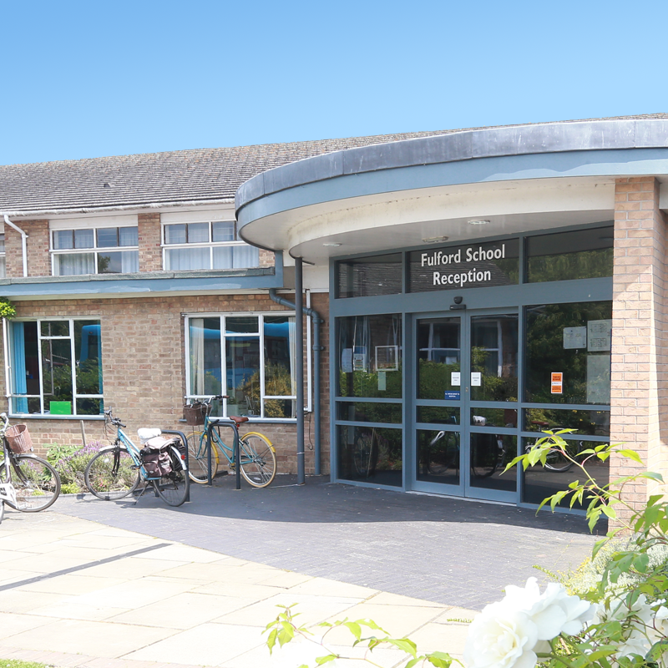

Slide 4


Slide 5


Slide 6


Slide 7



Slide 8


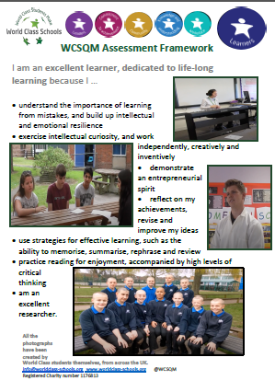

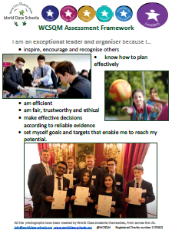

Commitment; Community; K.&E.; Leaders; Learners; Workplace

Slide 9



Slide 10


