Slide 1
FULFORD SCHOOL
Honesty
Empathy
Ambition
Respect
Tolerance

Slide 2
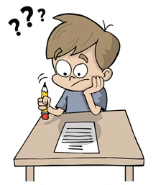
Rewards and Sanctions routines 2019+20
Homework support
Mr Lynn (progress leader)
September 2021

Slide 3
Homework – why bother?
‬Reports conducted found that the completion of homework at secondary level can add on an additional 5‭ ‬months‭ ‬progress onto a child’s learning‭.‭
(‬Education Endowment Foundation‭, ‬2016‭)
Research that focuses on the link between homework and academic achievement we see that homework does in fact have a positive impact on students’‭ ‬grade. (Sharp 2002)
Homework can help to improve relationships between parents and students, ‬bringing them‭ ‬‘closer together to enjoy learning and exchange ideas’‭. (Epstein‭ ‬&‭ ‬Van‭ ‬Voorhis 2001)
Homework has a fundamental part to play in the learning process‭ ‬‘and paving the way to students becoming independent learners’‭. ‬ (Sherrington‭ ‬2012‭)

Slide 4
Homework expectations
Homework support
Homework rewards

Slide 5
Homework expectations
For curriculum areas that have more than one lesson a week, homework is set once a week.
For curriculum areas that have one lesson a week, homework is set once a fortnight.
In Years 7, a piece of homework should last approximately 30 minutes. This time may lengthen during these year as students mature and progress through the key stage.
Rewards/sanctions…

Slide 6
Homework support
Homework club – a 20 min homework club will run every Friday lunchtime in G7 (computer room with a printer).
This will allow students to access class charts and print of any worksheets for the weekend etc.
Resource centre – (Mr Bailey)
QR Code – Curriculum leaders have sent a list of suitable homework websites which can be accessed via the QR codes printed around the room (please scan to use).

Slide 7
Homework rewards
If students successfully complete work to a suitable standard they will receive a positive ‘homework positive’ via class charts.
If homework isn’t completed without good reason a ‘homework negative’ will be issued via class charts.
Chocolate Friday: Students that receive 3 positives for a combination of:
- Homework,
- effort
- half-terms progress focus (independence, organisation, reflection, teamwork, creativity, resilience)
will receive a chocolate Friday nomination for a chance to win a chocolate bar.

Slide 9
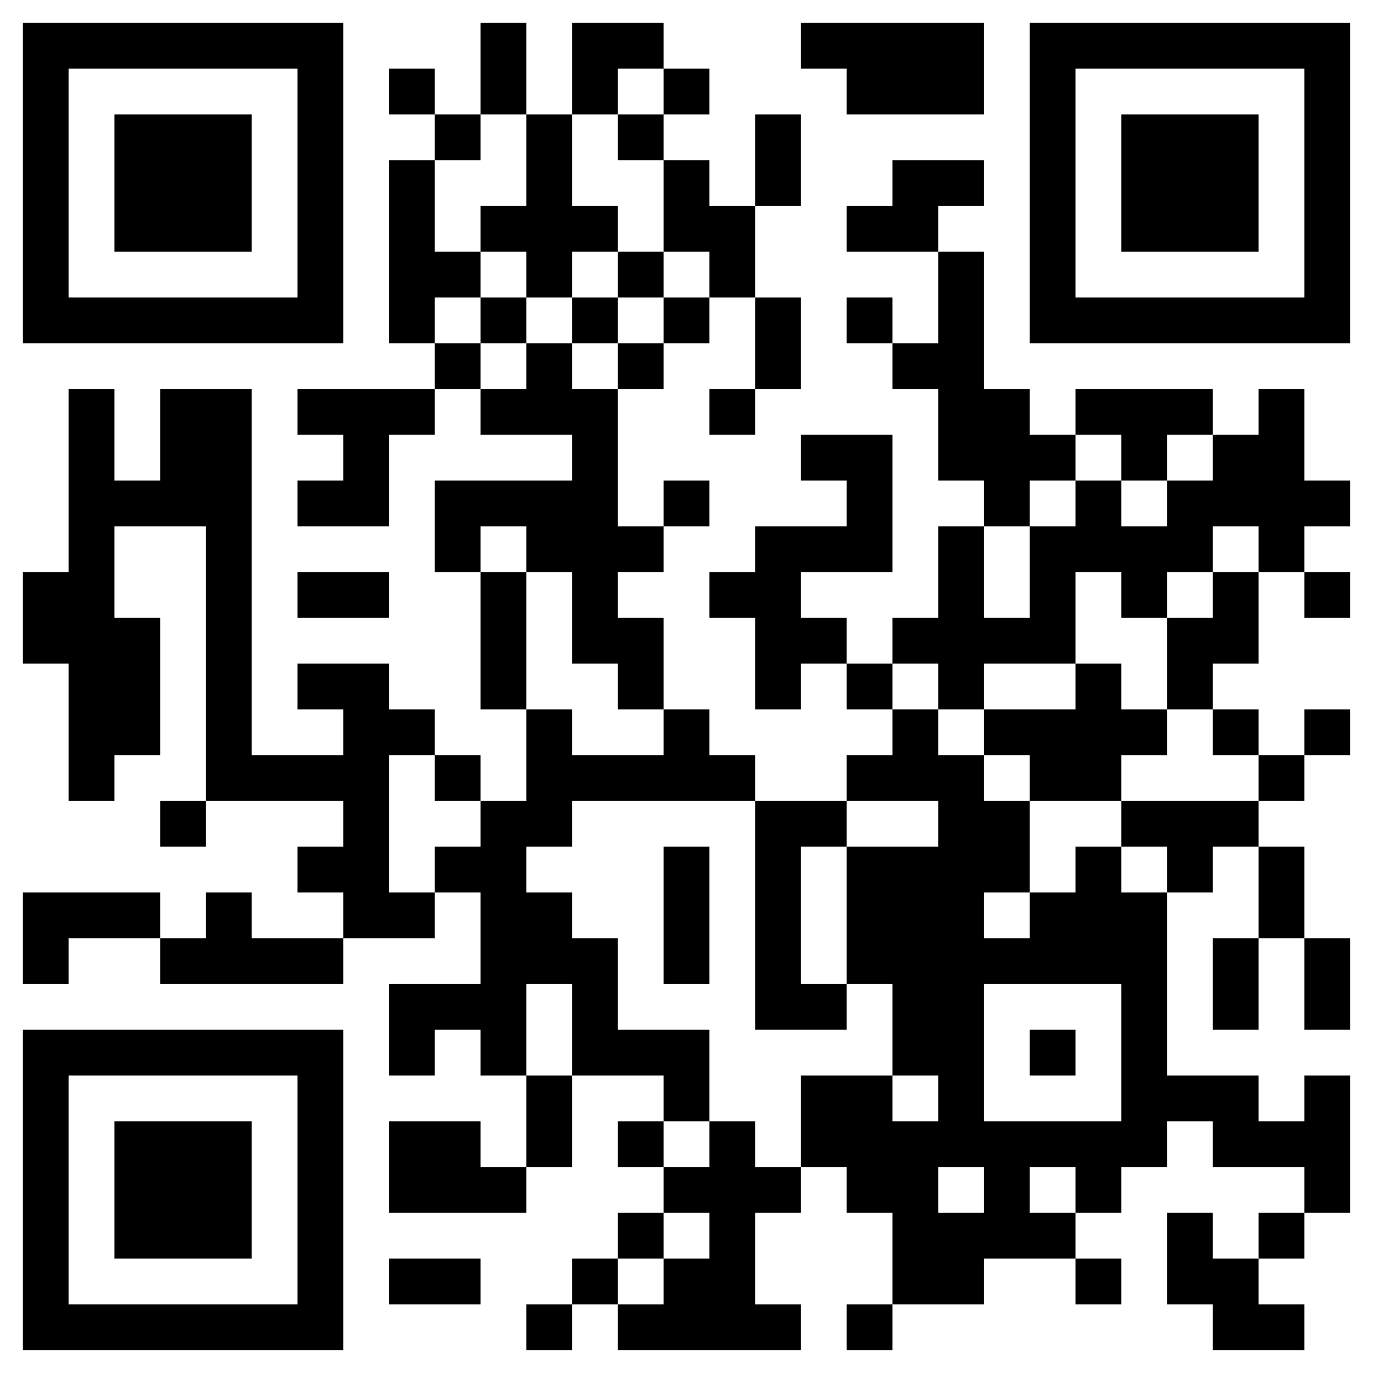
QR Code for year 7 homework resources:

Slide 10
Questions/concerns
Head of year – Fay Chapman (chapmanf@Fulford.york.sch.uk)
Assistant head of year Dean Wharton (whartond@Fulford.york.sch.uk)
Progress leader – Sam Lynn (lynns@Fulford.york.sch.uk)

Slide 11
FULFORD SCHOOL
Honesty
Empathy
Ambition
Respect
Tolerance

