Slide 1
Year 7 Information Evening Mr Paul Walker Assistant Headteacher
HONESTY, EMPATHY, AMBITION, RESPECT, TOLERANCE

Slide 2
Issues and Support
HONESTY, EMPATHY, AMBITION, RESPECT, TOLERANCE

Slide 3
HONESTY, EMPATHY, AMBITION, RESPECT, TOLERANCE

Slide 4
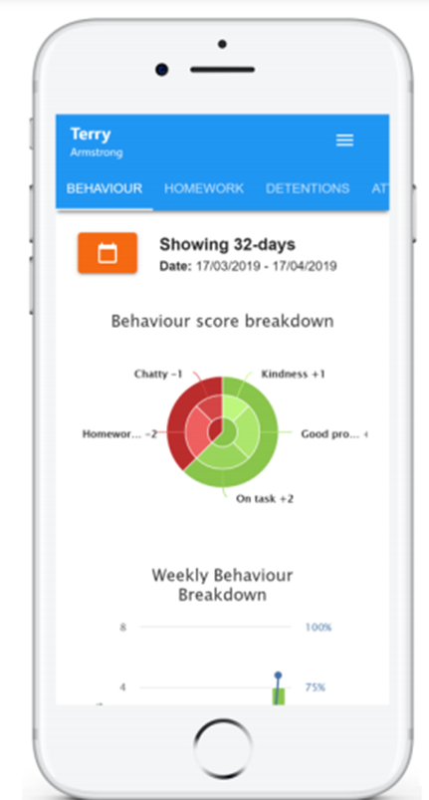
HONESTY, EMPATHY, AMBITION, RESPECT, TOLERANCE

Slide 5
Regular Updates
HONESTY, EMPATHY, AMBITION, RESPECT, TOLERANCE

Slide 6
Positive Behaviour Recognition
HONESTY, EMPATHY, AMBITION, RESPECT, TOLERANCE

Slide 7
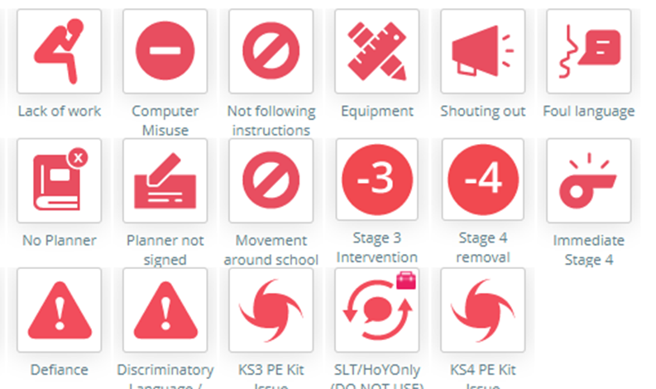
Negative Behaviour Recording
HONESTY, EMPATHY, AMBITION, RESPECT, TOLERANCE

Slide 9
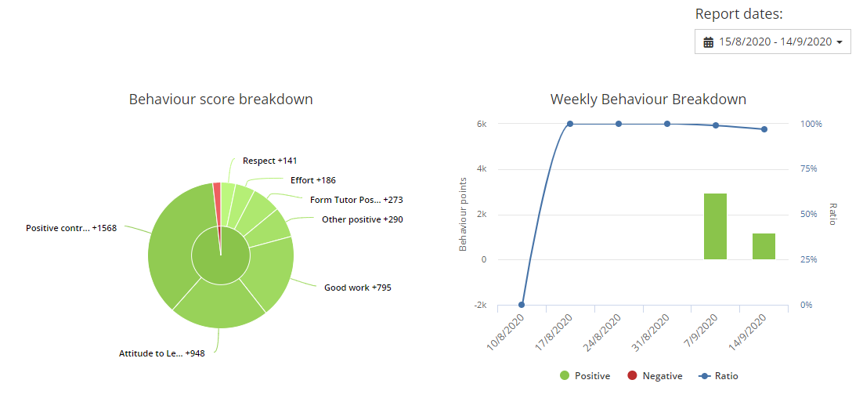
Regular Updates
HONESTY, EMPATHY, AMBITION, RESPECT, TOLERANCE

Slide 10
Homework
HONESTY, EMPATHY, AMBITION, RESPECT, TOLERANCE

Slide 11
Timetable and Classes
HONESTY, EMPATHY, AMBITION, RESPECT, TOLERANCE

Slide 12
Regular Updates
HONESTY, EMPATHY, AMBITION, RESPECT, TOLERANCE

Slide 13
Issues and Support
Email: classcharts@fulford.york.sch.uk
HONESTY, EMPATHY, AMBITION, RESPECT, TOLERANCE

