Slide 1
Do you ever wonder why some people take up sports and some people do not?
Do you enjoy your PE lessons?
Are you a good leader?
Have you ever wondered what Career you could have in the sports world?
Do you go to lots of sports clubs outside of school?
Are you interested in healthy lifestyles?
Are you interested in diet and nutrition?
Would you like to meet friends with people who also like sport?
Are you interested in the structure and function of the body when we exercise?
Have ever thought about the Psychological factors during sport?
Does your PE teacher or lessons inspire you to take it further?
Do you enjoy learning about the different training methods in sport?
Have you ever wondered how physical exercise impacts your learning?

Slide 2
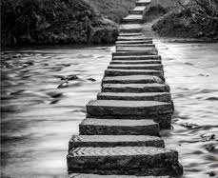
Have you thought about a Career in Sport?
But your not really sure which path to go on????
How to get there?
What to do to get there?
What do you need to get there?

Slide 3
In coaching
In community sport
In administration and management
In psychology
So what could the career be?
In journalism
In fitness
In coaching
In Health
In professional sport
In sports good companies

Slide 4
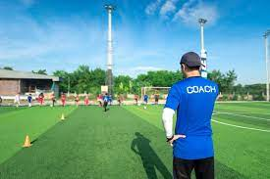
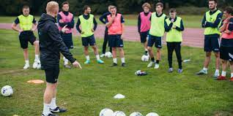
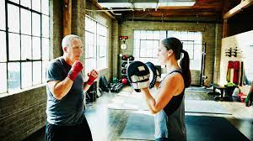
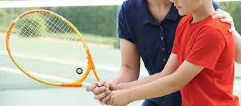
For holiday camps
In community sport
In schools and colleges
In professional sport
In coaching
In gyms and fitness centres
In private sports clubs
Fitness Instructor
In fitness
Strength and conditioning coach
Personal trainer
Health trainer

Slide 5
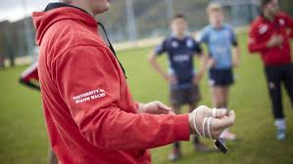
In community sport
Youth sport officer
Coach
Sports development officer
In teaching
In psychology
Primary
Secondary
Exercise psychology
Sports psychology

Slide 6
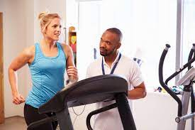
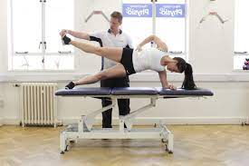
Sports medic
Sports physiotherapist
Sports nutritionist
Exercise physiologist
In Health
Biomechanist
Sports therapist
Sports statistician
In journalism
Photographer
commentator
Writer

Slide 7
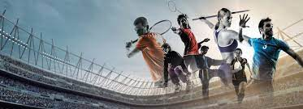
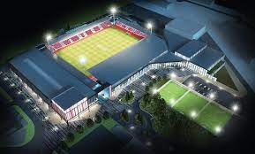
In gyms and fitness centres
In outdoor pursuits centres
In a local authority
In sports clubs
In administration and management
In stadiums and arenas
In leisure centres
In sports companies
Marketing
Product development
Sponsorship
Sales

Slide 8
What can I do to start my sports career pathway at Fulford School?
Key stage 3
Key stage 4
Key stage 5
Learn and develop:
Applied anatomy and physiology
The structure and function of the Cardio-respiratory system
Anaerobic and aerobic exercise
Movement analysis
Physical training
Sports Psychology
Socio-cultural influence
Commercialisation
Ethical issues
Health and fitness
Use of data
Get more involved by:
Join a school club
Join a local club
Represent school
Learn and develop:
Key skills and technique
Leadership skills
Communication skills
Application of rules and tactics
Officiating
Get more involved by:
Join a school club
Join a local club
Represent school
Learn and develop:
Anatomy and physiology
Fitness training programming
Professional development in sports careers
Practical sports performance
Get more involved by:
Sport Leadership in the community
Play a new sport

