Slide 1
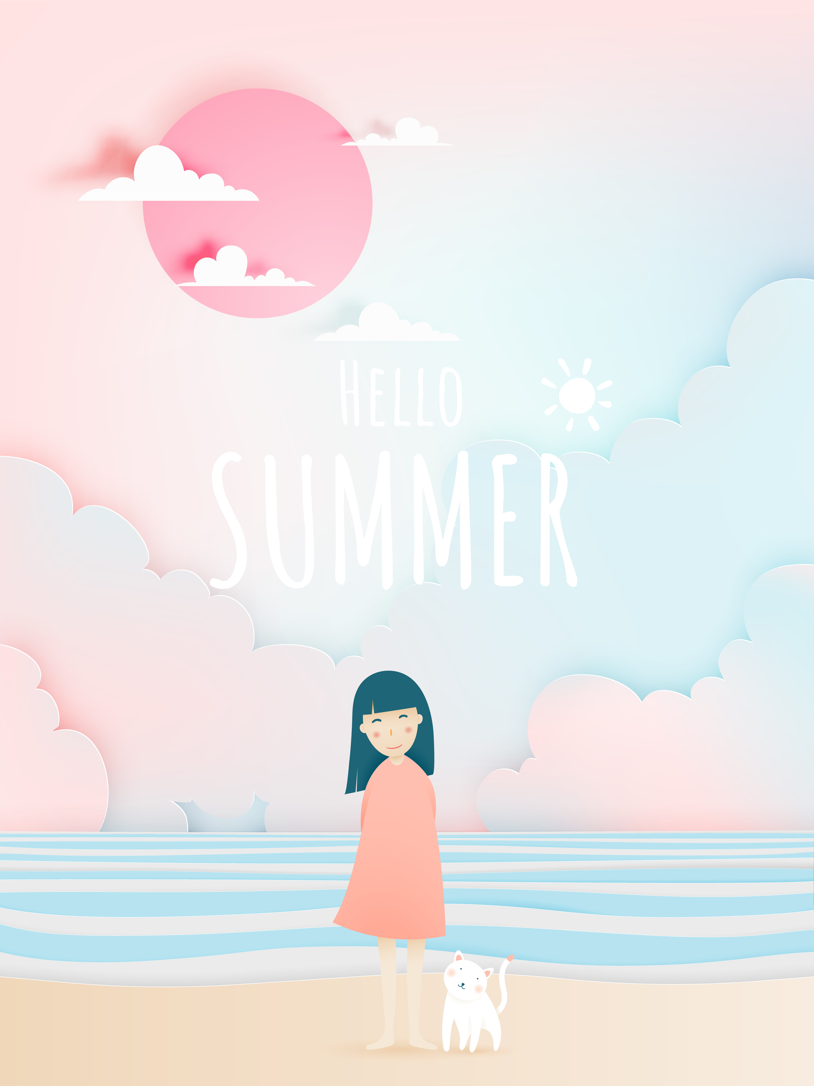
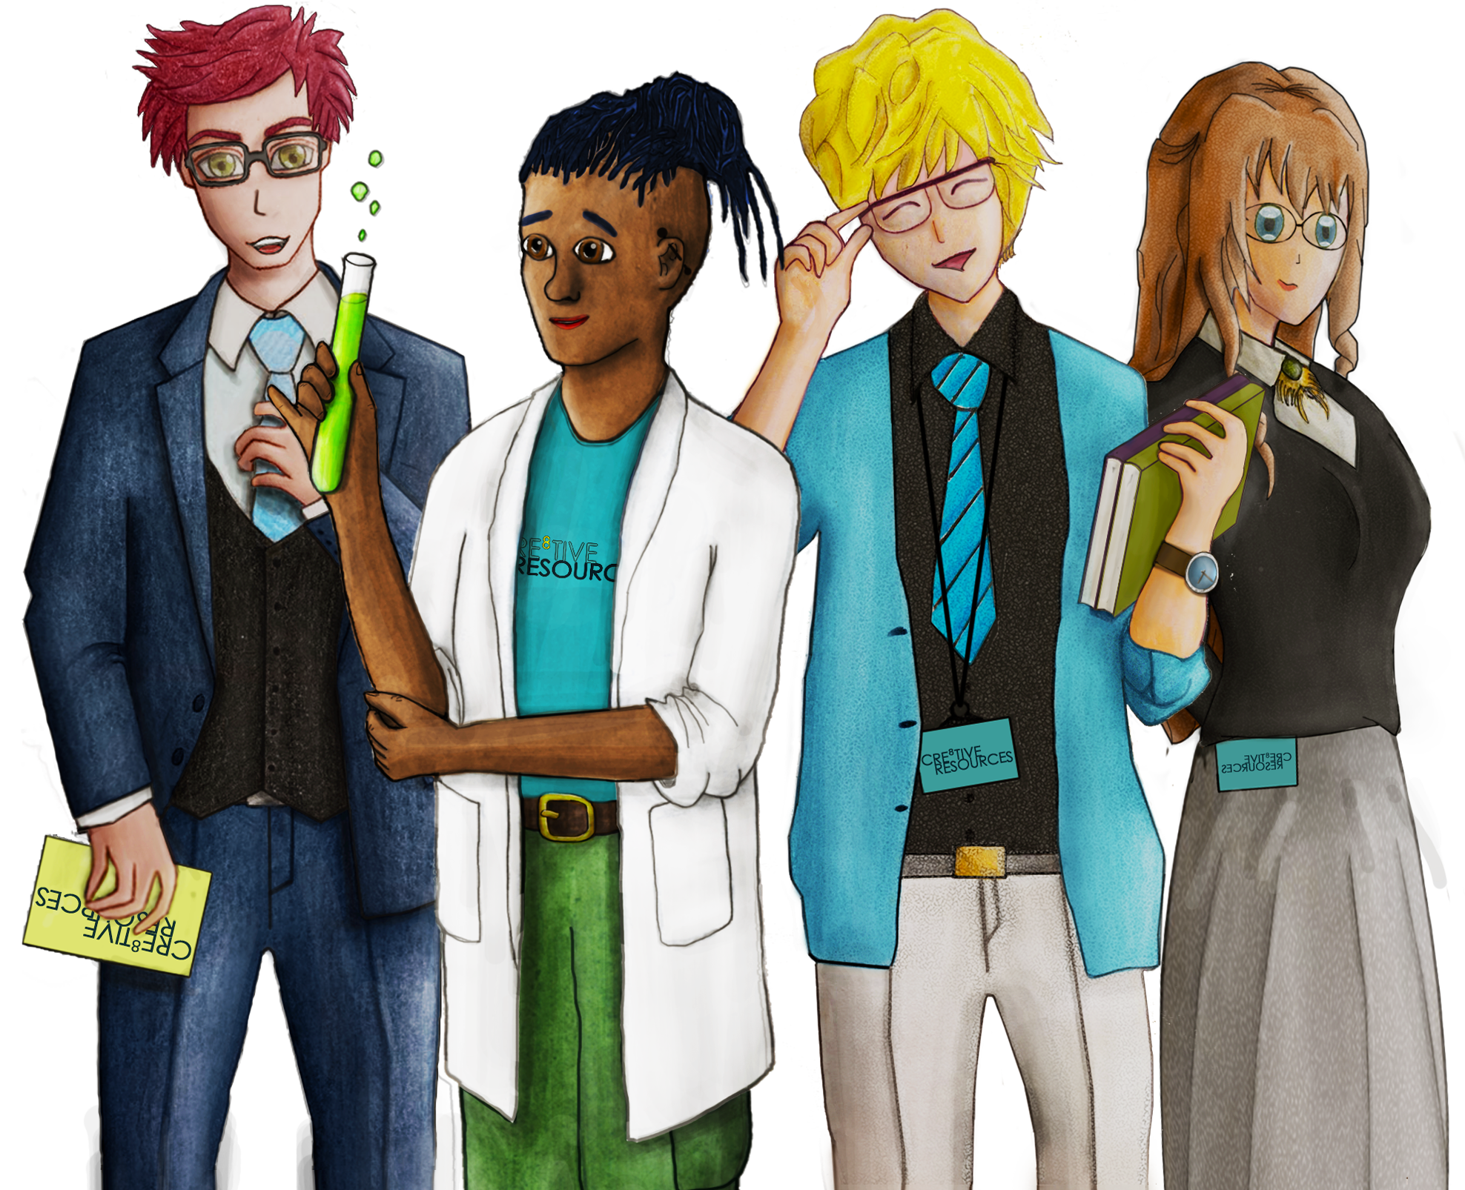
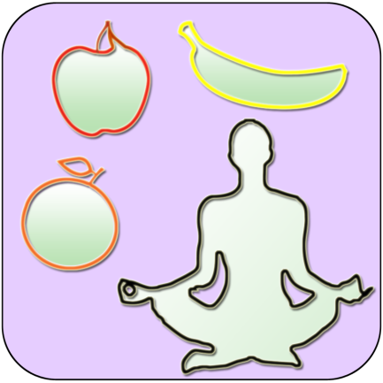
30 Day #Wellbeing Challenge
Day 1 Smile and say good morning to everyone in your household. | Day 2 Take 5 minutes to write down your feelings today. | Day 3 Do 20 Jumping Jacks and 50 knee ups.
Day 4 Visit an art gallery! Go online and explore the collections online. | Day 5 Reply to a pen pal or to someone you have not spoken to in a long time. | Day 6 Design a pair of trainers or shoes.
Day 7 Read 20 pages from the book you are reading or start a book | Day 8 Come up with a 10 question multiple choice quiz | Day 9 Listen to your favourite song and dance around the room.
Day 10 Go to bed 1 hour earlier tonight to wake up 1 hour earlier tomorrow. | Day 11 Sit down and focus on your breath for 5 minutes. | Day 12 Play a card game or board game you haven’t played in a while.
Day 13 Write a letter of appreciation to someone who helps. | Day 14 Draw and paint the most colourful thing in your house. | Day 15 Write a poem or short story.
Day 16 Ask your parent/caregiver about happy things in their life | Day 17 Research places you would like to travel to in your life time. | Day 18 Close your eyes and visualise your future life.
Day 19 Draw your favourite animal using geometric shapes. | Day 20 Use 10 French or Spanish words today. | Day 21 Make sure you get >8 hours sleep tonight. Note how you feel the next day.
Day 22 Draw but listen to your favourite music. See what flows naturally | Day 23 Do something nice for a sibling or parent/carer. | Day 24 Stretch and move your body any way that feels good for 10 minutes
Day 25 Clean a room in the house that is not your bedroom. | Day 26 Design a pair of trainers or shoes. | Day 27 Tidy your room, maybe re organise the layout.
Day 28 Ensure you have >5 fruit and veg today – Write them all day | Day 29 Do something helpful for a friend or family member today. | Day 30 Write down 10 things you love about your life
Notes:
This is not an exhaustive list but just some suggestions that may be helpful!
Please keep up to date with government guidance and take care of yourselves

