Slide 1
Hi new Year 7 students,
Thank you and well done to those of you that completed the task from last week. It was great to read about the things you want to achieve and the lessons you learnt from things that didn’t quite go to plan. If you didn’t get round to attempting last week’s task, don’t worry as you can complete the one for this week.
Starting secondary school is a really exciting time. Here at Fulford we want you to feel prepared and ready to embrace the many fantastic opportunities that will come your way. The weekly tasks we are setting you are aimed at building your confidence and resilience, along with developing a positive attitude to allow you to ‘Be Awesome’. It will also give us a chance to get to know more about you.
Everyone is different and will respond to the transition to secondary school in different ways. If you look after yourself, care for those around you and always give your best effort you have nothing to worry about. Just know that there are many other students in exactly the same position as you who are all trying to make new friends and adjust to a new school life.
Have a go at completing the task either on your laptop or computer. Then feel free to share it with us by emailing it to Year6transition@Fulford.York.sch.uk. We look forward to hearing from you.

Slide 2
The weekly tasks that we are setting you are based on ideas that originate from a book written by Matthew Syed called ‘You Are Awesome’.
At Fulford, we really try to encourage students to read outside of school to develop their literacy skills. This is a fantastic book which is really easy to read. It would help you to understand some of the tasks and prepare you for some of the challenges you will face at secondary school.

Slide 3
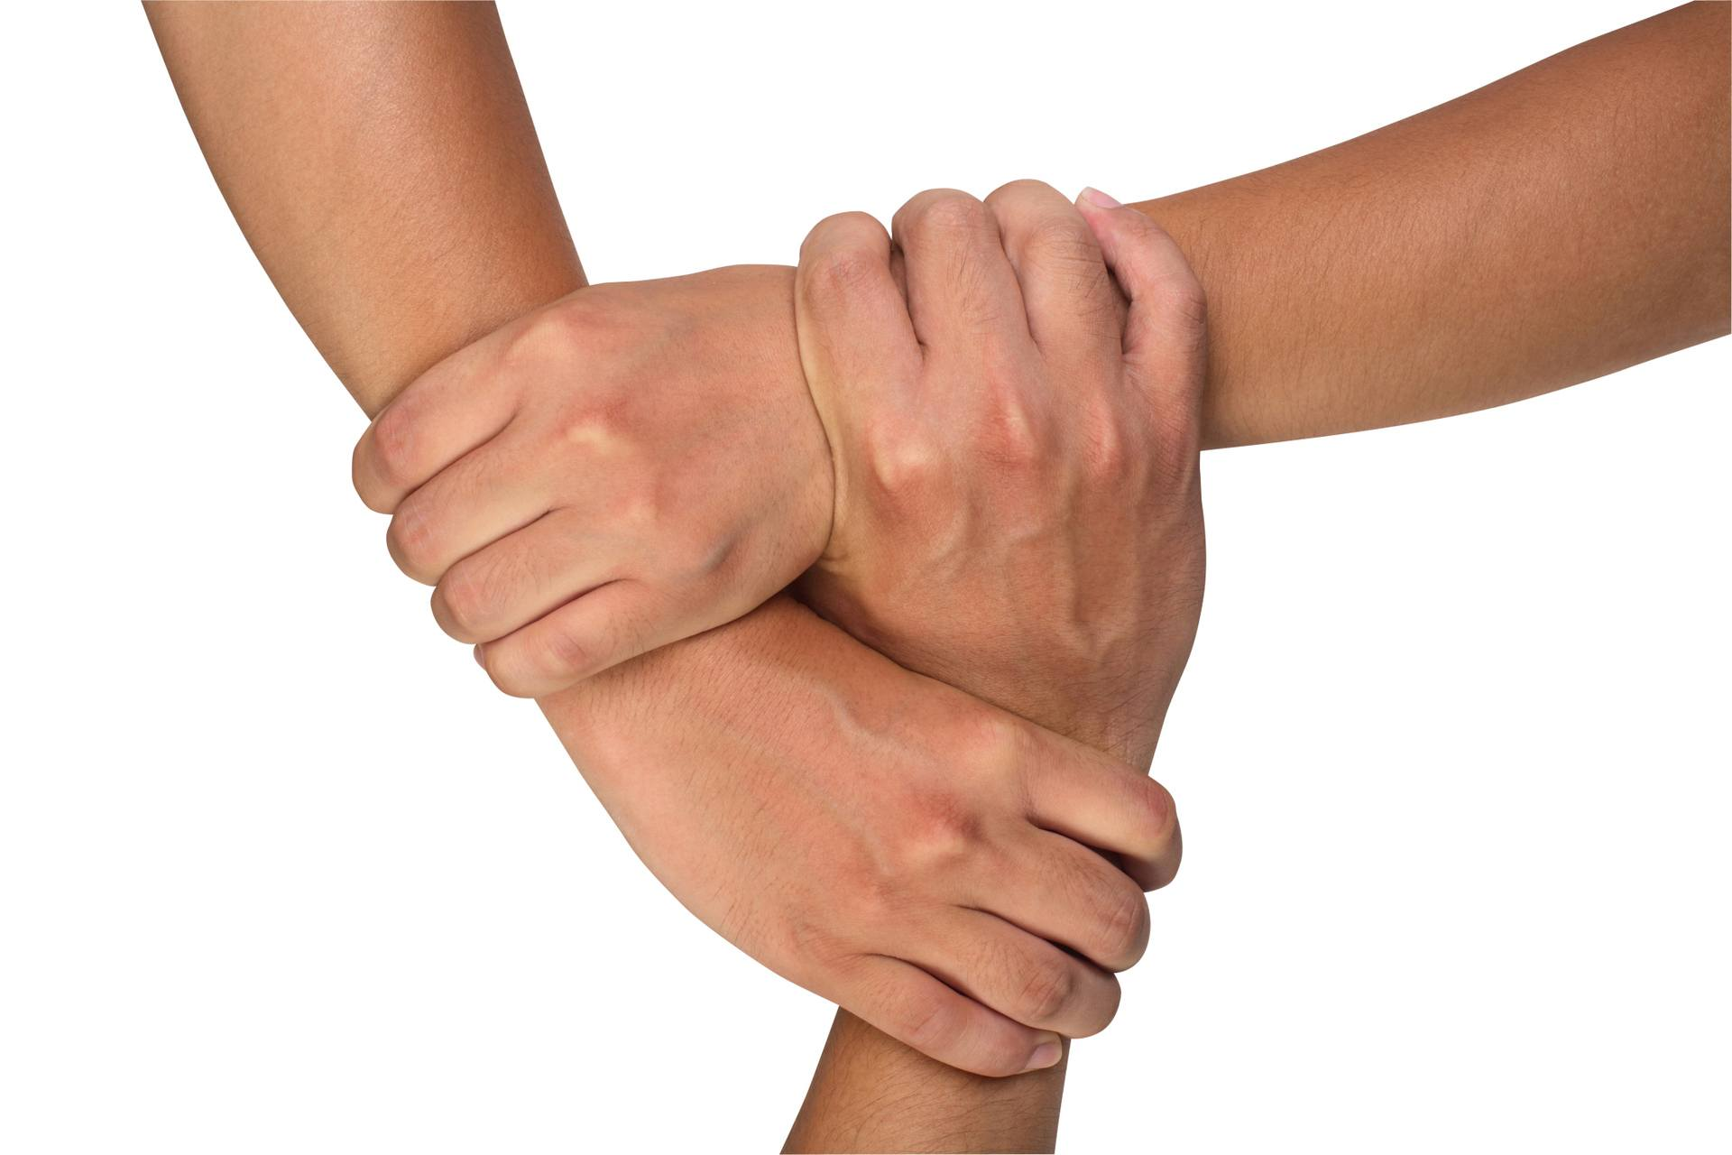
Week 6 – Feeling Supported
Starting secondary school is a huge step up from primary school and it is understandable to feel worried and nervous. One of the best ways to overcome this is to think about all the people around you that can support you when you might need it. We all need someone to talk to when things get tough. Here at Fulford there are so many people that can do this and you should have met many of these people already. We want you to use this task to think about all the people that will form a support network around you.
The Triangle of Trust
The Triangle of Trust represents three people that you can trust and talk to. Write down who is in your Triangle of Trust by putting their names on the outside of each side of the triangle. It can be anyone from home or school.
Who can you talk to about different things?
What three things makes you feel happy and good?
1.
2.
3.
Where is your safe place to just relax?
Write down all of the ways in which you are different and unique.
How may these help you in your new school or in life?

Slide 4
Friendships
What kind of friends do you want to have in secondary school? Make a list.
What kind of friend do you want to be to other people? Make a list.
Your friendships
Who makes you laugh?
Who is a good listener?
Who can you trust?
Who will give you an honest opinion?
Who will help you get through the transition to secondary school?

