Slide 1
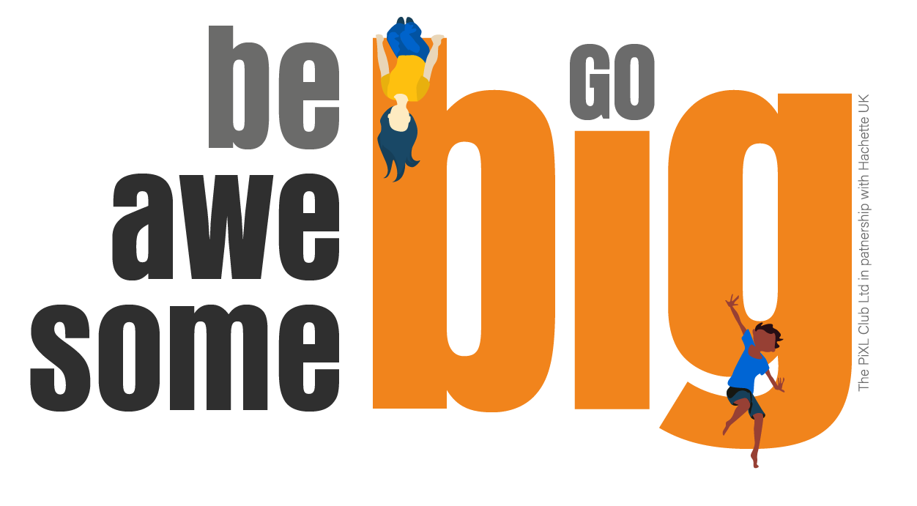
Hi new Year 7 students,
Thank you and well done to those of you that completed the task from last week. I received some brilliant responses and it was great to read about some of the things you are looking forward to when you start in September. If you didn’t get round to attempting last week’s task, don’t worry as you can complete the one for this week.
Starting secondary school is a really exciting time. Here at Fulford we want you to feel prepared and ready to embrace the many fantastic opportunities that will come your way. The weekly tasks we are setting you are aimed at building your confidence and resilience, along with developing a positive attitude to allow you to ‘Be Awesome’. It will also give us a chance to get to know more about you.
Everyone is different and will respond to the transition to secondary school in different ways. If you look after yourself, care for those around you and always give your best effort you have nothing to worry about. Just know that there are many other students in exactly the same position as you who are all trying to make new friends and adjust to a new school life.
Have a go at completing the task either on your laptop or computer. Then feel free to share it with us by emailing it to Year6transition@Fulford.York.sch.uk. We look forward to hearing from you.

Slide 2
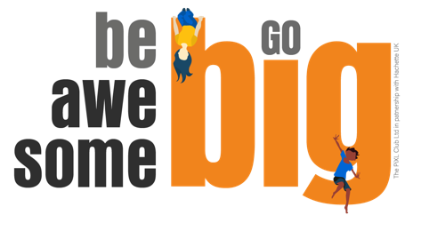
The weekly tasks that we are setting you are based on ideas that originate from a book written by Matthew Syed called ‘You Are Awesome’.
At Fulford, we really try to encourage students to read outside of school to develop their literacy skills. This is a fantastic book which is really easy to read. It would help you to understand some of the tasks and prepare you for some of the challenges you will face at secondary school.

Slide 3
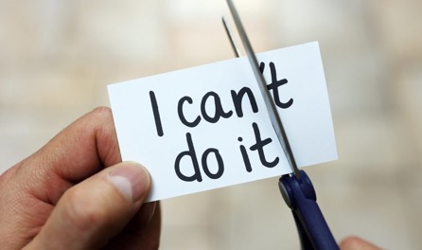
Week 4 – ‘Bouncebackability’
The term ‘bouncebackability’ has been used to describe the word ‘resilience’. Resilience is such an important characteristic and one of Fulford’s key learning attributes. We will always encourage you to develop your resilience so you can respond quickly to set backs and learn from your mistakes. Everyone fails at some point but it is the ones who learn from it that are the most impressive.
Task: Watch this video clip to give yourself an idea of what resilience looks like: https://www.youtube.com/watch?v=An2OaIbPSII&list=PLDeWrIftuhV1M32LZNtYPhqap7ayeW207
How do you handle bouncing back?
Answer the following questions/finish the sentences:
I have shown ‘grit’ when…
2. I need to show more determination when…
3. How do you handle making a mistake? What is your reaction?
4. Think of a time when you made a mistake. Were you kind to yourself?

Slide 4
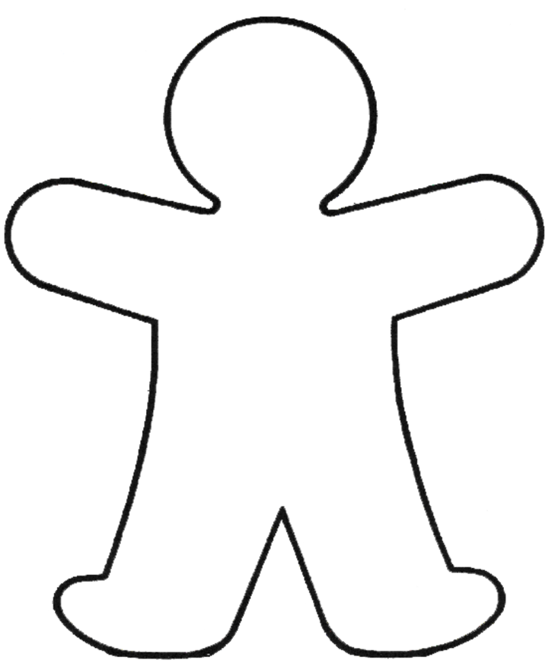
What does ‘work hard’ and ‘be kind’ mean?
Fill in the person outline with all the things that you can do to show you are working hard.
Now think about what you can do to be kind. Add these to the outline.
How many of these things do you do already?
Highlight the ones that you would like to do more of!

