Slide 1


Hi new Year 7 students,
Thank you and well done to those of you that completed the task from last week. I received some fabulous responses and really enjoyed reading about some of the ways you have shown a ‘kid awesome’ attitude. If you didn’t get round to attempting last week’s task, don’t worry as you can complete the one for this week.
Starting secondary school is a really exciting time. Here at Fulford we want you to feel prepared and ready to embrace the many fantastic opportunities that will come your way. The weekly tasks we are setting you are aimed at building your confidence and resilience, along with developing a positive attitude to allow you to ‘Be Awesome’. It will also give us a chance to get to know more about you.
Everyone is different and will respond to the transition to secondary school in different ways. If you look after yourself, care for those around you and always give your best effort you have nothing to worry about. Just know that there are many other students in exactly the same position as you who are all trying to make new friends and adjust to a new school life.
Have a go at completing the task either on your laptop or computer. Then feel free to share it with us by emailing it to Year6transition@Fulford.York.sch.uk. We look forward to hearing from you.

Slide 2


The weekly tasks that we are setting you are based on ideas that originate from a book written by Matthew Syed called ‘You Are Awesome’.
At Fulford, we really try to encourage students to read outside of school to develop their literacy skills. This is a fantastic book which is really easy to read. It would help you to understand some of the tasks and prepare you for some of the challenges you will face at secondary school.

Slide 3
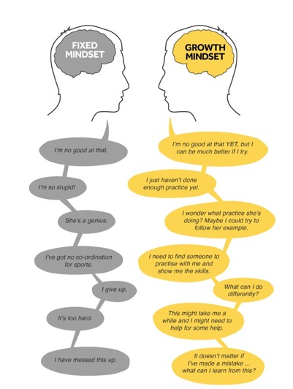
Week 2 – Unlocking Your Mind
Having the right attitude and mind-set is really important in allowing you to improve. This week is all about changing your mind-set so you can approach things in a positive and resilient way whilst learning from your mistakes.
TASK: watch this video clip on the two different mind-sets: https://www.youtube.com/watch?v=Xv2ar6AKvGc
TASK:
Look at these two people, each with a different mindset and read their thoughts.
Which mindset are you and why?
Does it change depending on different situations in your life?
Are you someone who thinks that you are just born intelligent?

Slide 4
The Worry Jar
What are the things you tend to worry about which might stop you from trying something new or hard?
Write them down on strips of paper (or you can write them down in your booklet).
Put those strips of paper in a worry jar – any jam jar or a pot will do.
In a week’s time, look at the strips of paper again (maybe with a parent or sibling) and see if the worries still apply.
Throw away the ones that don’t.
Take a look at the ones that are still worrying you. Is there someone you can talk to about these?

Slide 5

Use this time before Year 7 to have a go at things.
TASK:
Identify three things that you say you ‘can’t do’. Write them down.
1.
2.
3.
Now write each thing down using a growth mindset approach. For example, ‘I can’t do maths’ turns into, ‘I am going to practise the things in maths that I can’t do yet’.
1.
2.
3.
Think of something you’ve always wanted to get better at. Write it down. How could you practise that thing now?

