Slide 1
My New Species
Transition project

Slide 2
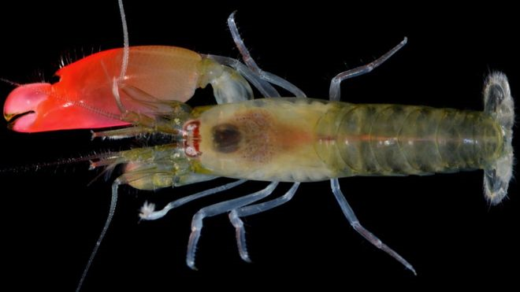
New shrimp ‘Pink Floyd’ - discovered this year
This new species was discovered off the pacific coast of panama.
It can make a noise so loud with its large pink claw that the noise can kill small fish! It then eats them.
Scientists named the shrimp ‘Pink Floyd’ after the rock band famous for their loud music!

Slide 3
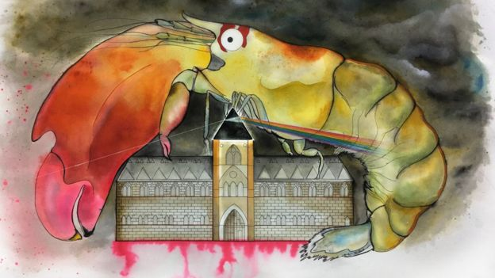
My New Species
We would like you to design a new species. There will be a vote for the best ones, with the winners receiving a prize when you move up to Fulford. Some things you could to think about:
Habitat
Appearance
Adaptations
Diet
Lifecycle
Where is it in the food chain?
Special features
Anything else?!
How are you going to present this?

